Slide 1
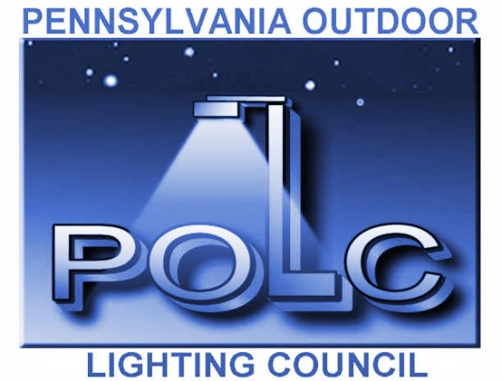
Outdoor Lighting
Planning Issues for
Municipalities
presented by
Pennsylvania Outdoor Lighting Council

Slide 2
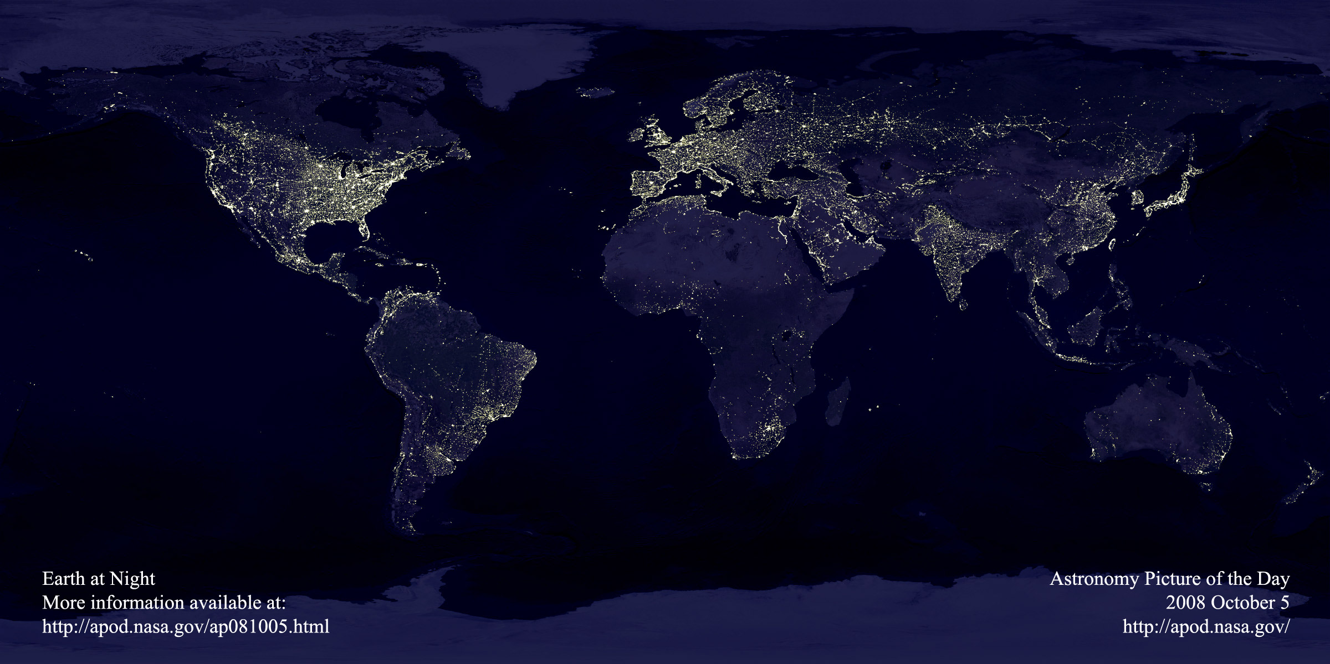
Outdoor Lighting Trends
Light pollution and billions of dollars of wasted energy

Slide 3
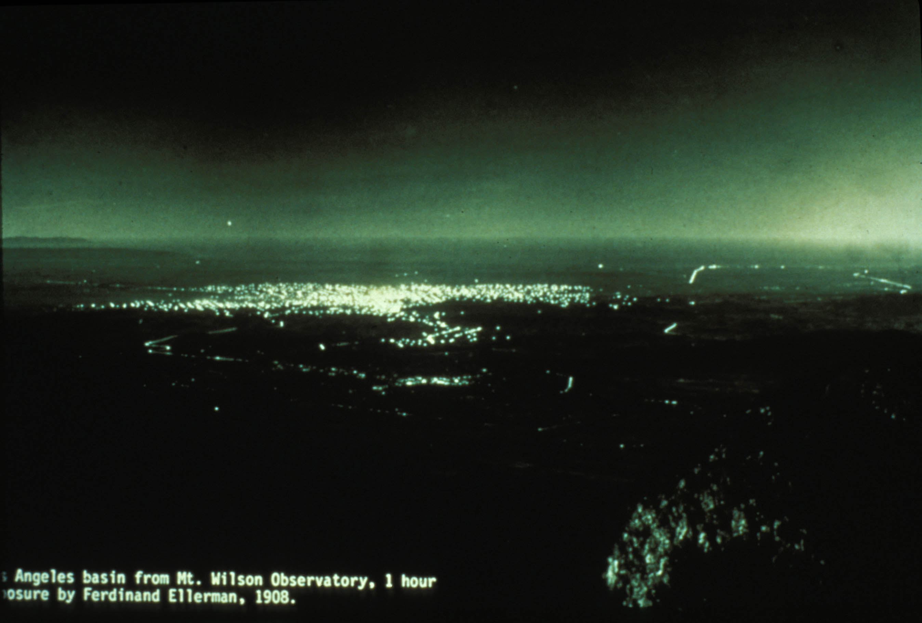
LA Basin 109 Years Ago

Slide 4
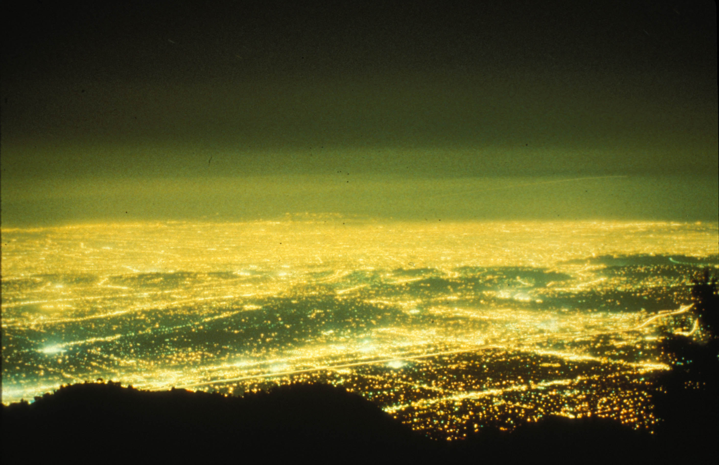
LA Basin 100 Years Later

Slide 5
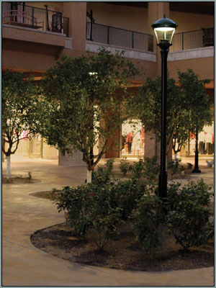
Why is good outdoor lighting important?
Good outdoor lighting is a community asset
Enhances safety and sense of security
Provides visibility for nighttime activities

Slide 6
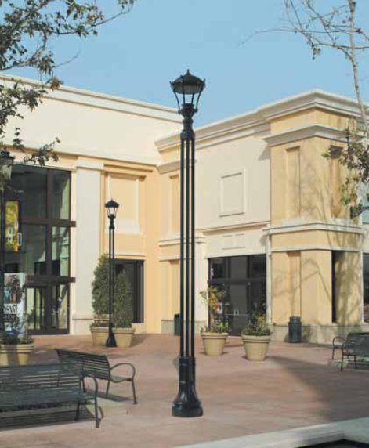
Why is good outdoor lighting important?
Strengthens the themes and goals of the community while highlighting its amenities
Communicates a positive visual image of the community, and visual order

Slide 7
The Downside
Careless and excessive use of light at night can be detrimental:
Glare – too much light in our eyes – nuisance, discomfort, loss of visibility
Light Trespass – light going where it isn’t wanted
Energy waste – uplight, light when or where it’s not needed
Adverse effects on human health – melatonin suppression, sleep disruption
Adverse effects on nocturnal animals/plants – breeding and feeding
Urban skyglow – natural beauty of the night sky largely lost

Slide 8
The Downside
Artificial light at night distorts environmental migratory cues - avian migration
Can decimate insect populations and interfere with age-old relationships between species
Artificial Light at Night is an environmental pollutant that impacts biodiversity, human health, and cultural heritage.
Notes:
Migratory birds are confused by illuminated skyscrapers
Small owls avoid moonlit nights because large owls will hunt them

Slide 9
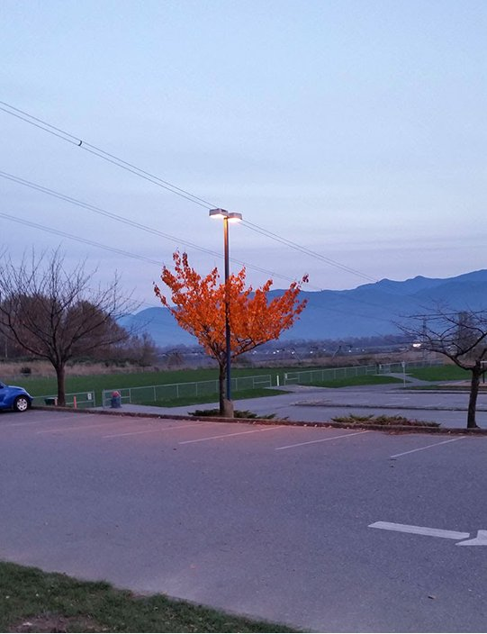
Impact on Plants

Slide 10
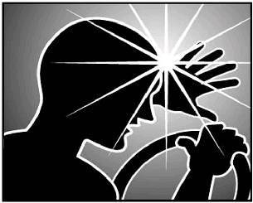
Glare
Good lighting aims and shields the source to prevent “glare.”
“Glare is light that causes annoyance, discomfort or loss in visibility

Slide 11
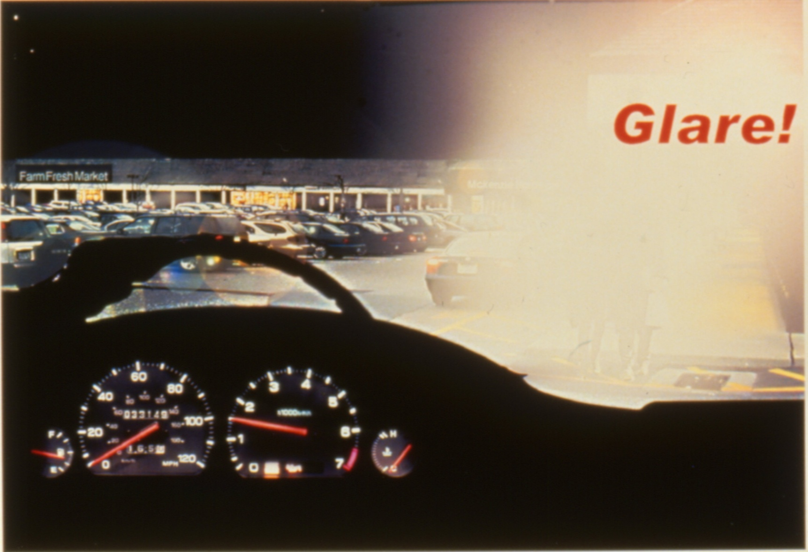
Glare
Courtesy RAB Lighting

Slide 12
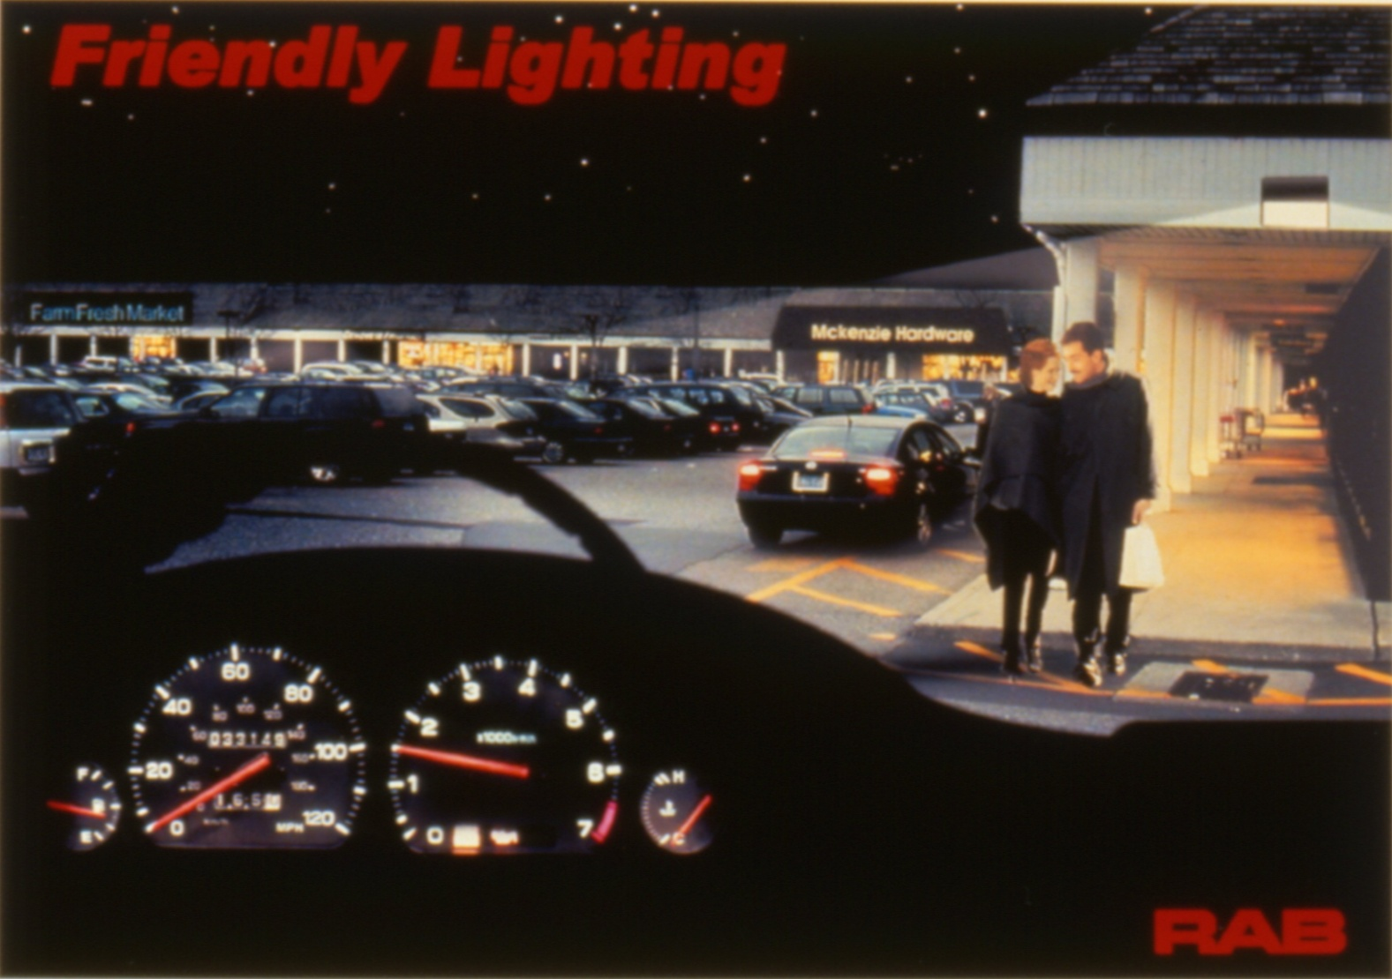
Glare Under Control
Courtesy RAB Lighting

Slide 13
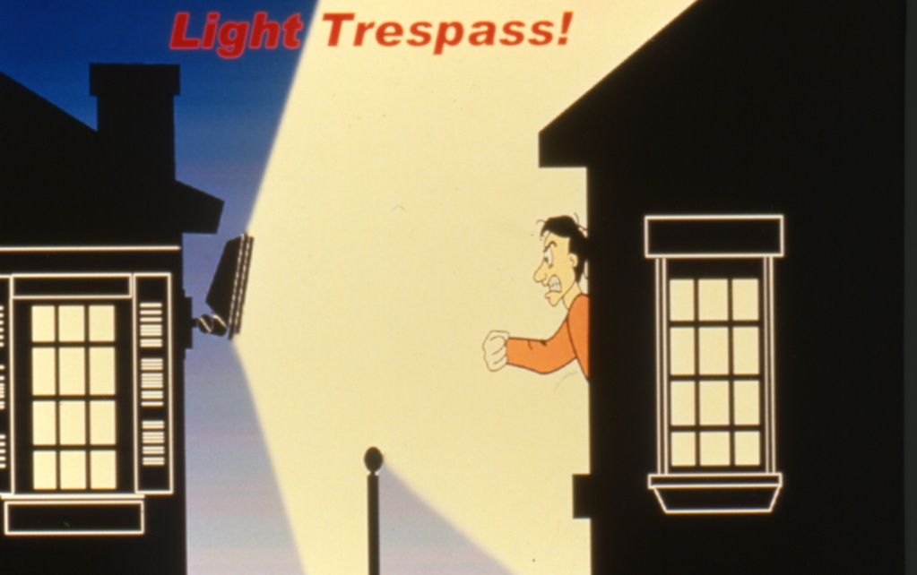
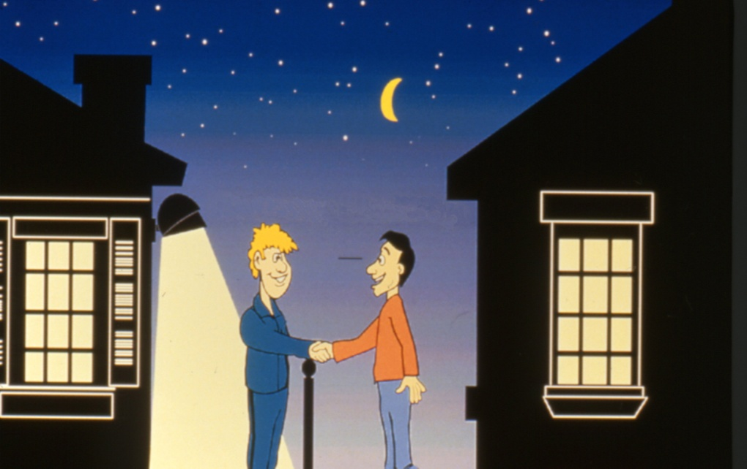
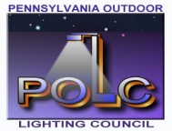
Light Trespass
Good lighting means placing the light only where it’s needed or is wanted, to prevent light trespass and sky glow.
Courtesy RAB Lighting
Courtesy RAB Lighting

Slide 14
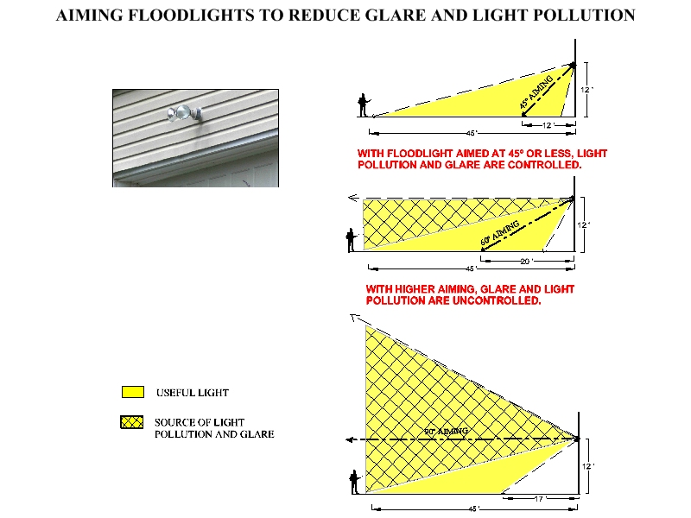

Slide 15
Goals of Good Outdoor Lighting
Optimize visibility at night
Minimize glare
Minimize light trespass
Minimize energy consumption
Minimize negative impact on the environment
Use the right amount of light, not too little and not too much

Slide 16
Goals of Good Outdoor Lighting
- Lighting should create the set of conditions where our visual system can work efficiently.
(We see objects by reflected light and by contrast)

Slide 17
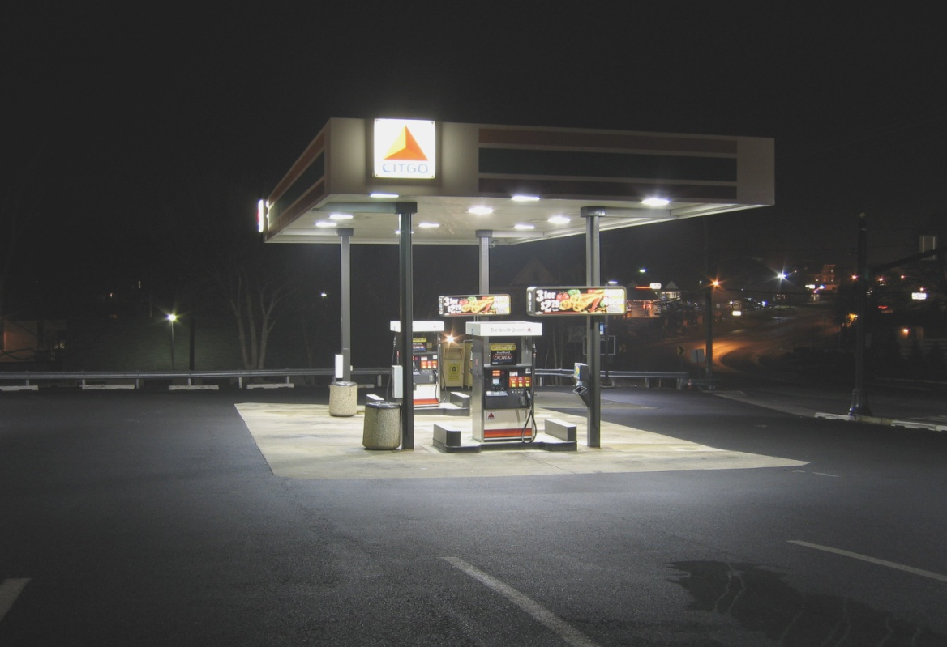
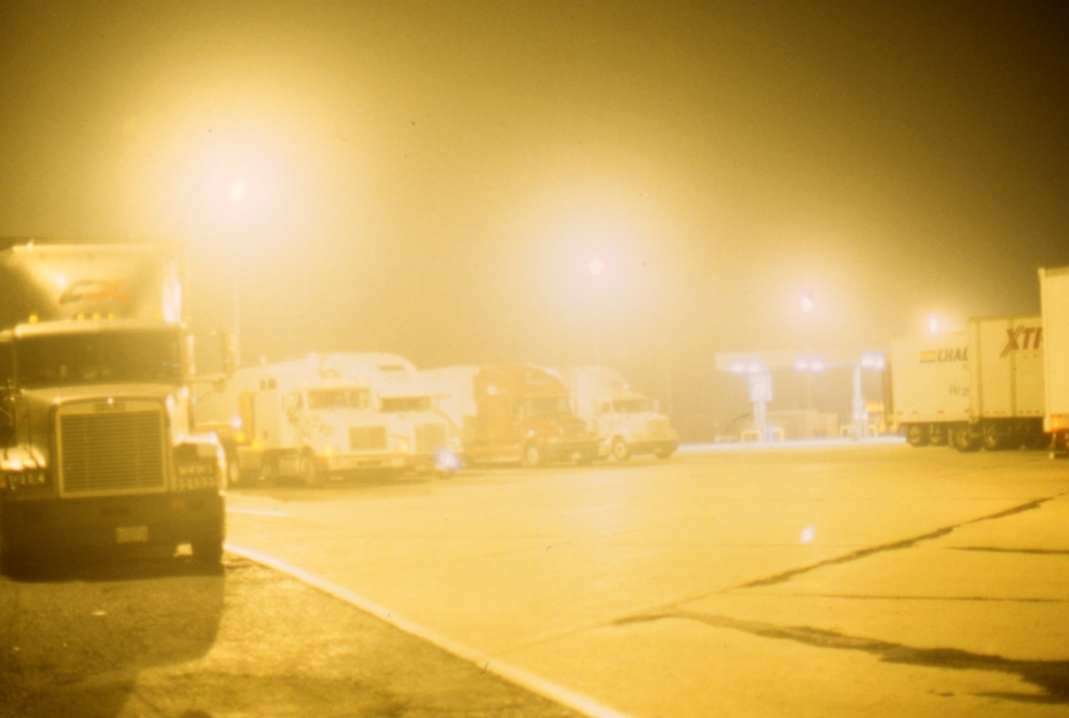
The Good and the Bad

Slide 18
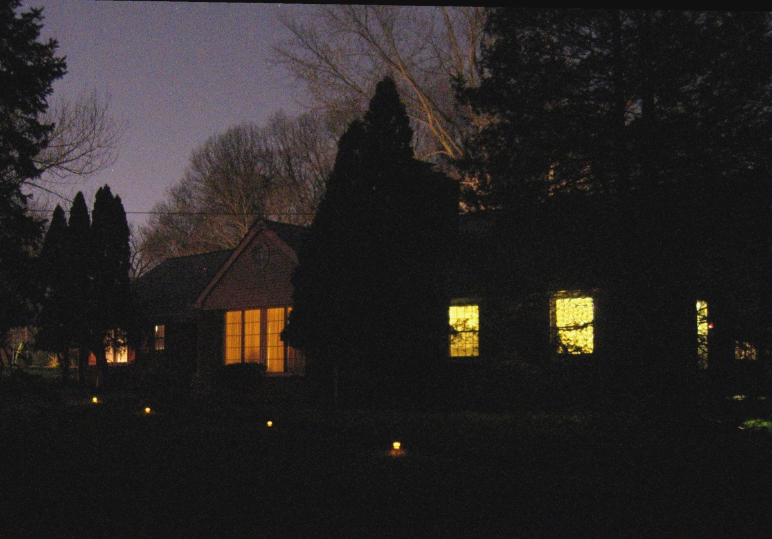
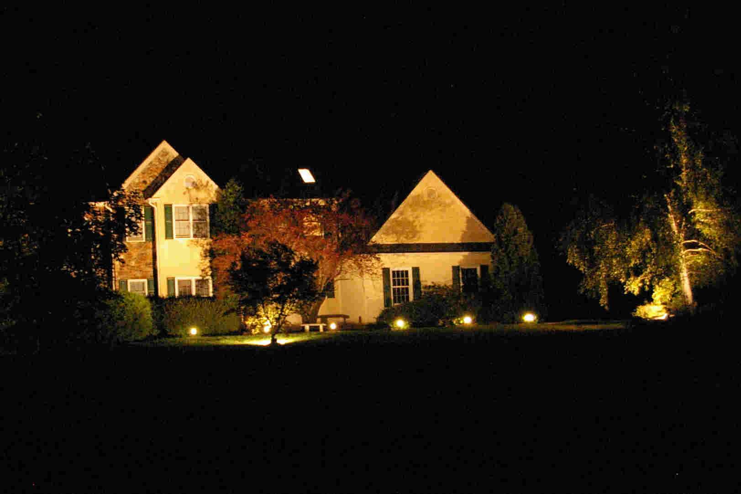
The Good and the Bad

Slide 19
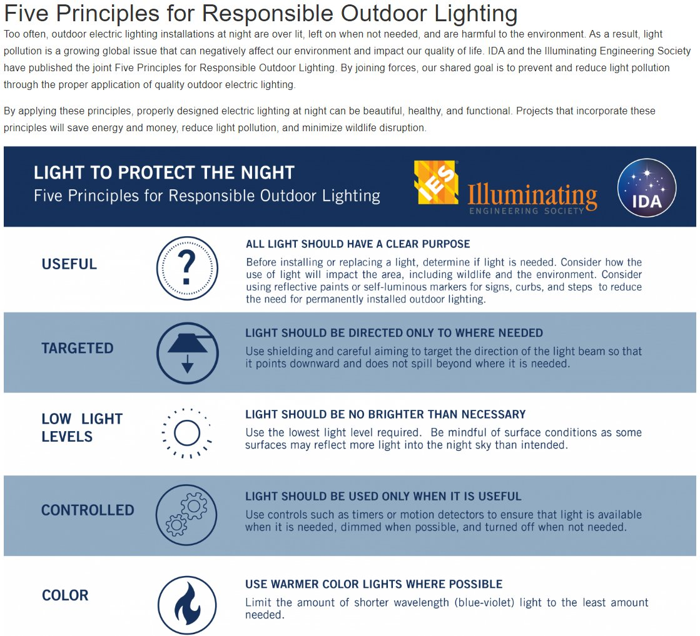

Slide 20
Today’s Situation
Too much money and energy are wasted in providing bad outdoor lighting
“Bad” lighting causes glare, and has too much or too little light for the outdoor seeing task
Bad lighting diminishes the quality of life in the community
Most people are unaware that much of our outdoor lighting fails to follow recognized good lighting practices

Slide 21
Common Myths of Outdoor Lighting
“More light means better visibility.”
  If more light also means more glare, then visibility can actually be reduced. Glare is never helpful for visibility.
  Lighting quality is as important to visibility as lighting quantity.
Notes:
Use the right amount of light, not too little and not too much
Minimize glare
Minimize light trespass
Minimize energy consumption
Minimize negative impact on the environment

Slide 22
Myths of Outdoor Lighting (Cont’d)
“More light means more security.”
  Poorly executed security lighting that creates glare and deep shadows can reduce visibility and actually aid criminals.
  Bright lighting can give an illusion of security. People can be induced to take risks that are not really justified by the overall situation.

Slide 23
Myths of Outdoor Lighting (Cont’d)
The Myth: “Security Lighting will reduce crime in urban outdoor areas.”
  A 1997 National Institute of Justice report to Congress said, “- - the effectiveness of lighting [as a crime deterrent] is unknown.” Results are mixed. We can have very little confidence that improved lighting prevents crime, particularly since we do not know if offenders use lighting to their advantage.”

Slide 24
Myths of Outdoor Lighting (Cont’d)
“We may speculate that lighting is effective in some places, ineffective in others, and counter productive in still other circumstances. The problematic relationship between lighting and crime increases when one considers that offenders need lighting to detect potential targets and low-risk situations (Fleming and Burrows 1986).

Slide 25
Myths of Outdoor Lighting (Cont’d)
Consider lighting at outside ATM machines, for example. An ATM user might feel safer when the ATM and its immediate surrounding area are well lit. However, this same lighting makes the patron more visible to passing offenders. Who the lighting serves is unclear.”

Slide 26
National Institute of Justice study, Feb., 1997
PREVENTING CRIME:
WHAT WORKS, WHAT DOESN'T, WHAT'S PROMISING
A REPORT TO THE UNITED STATES CONGRESS
Prepared for the National Institute of Justice
by Lawrence W. Sherman, Denise Gottfredson, Doris MacKenzie, John Eck, Peter Reuter, and Shawn Bushway
Department of Criminology and Criminal Justice
University of Maryland

Slide 27
How Did We Get Here?
Municipal codes have not kept pace with today's lighting technology, needs and practices
Municipalities have comprehensive building codes & electrical codes, and energy codes, but too few have an effective outdoor lighting ordinance
Electrical contractors have not gotten the word: their work is often characterized by the acronym GLUT =
Glare, Light Trespass, Uplight, Too much light
Municipalities see outdoor lighting as a commodity rather than an agent of environmental quality

Slide 28
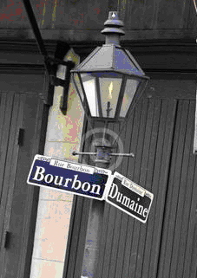
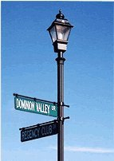
How Did We Get Here? (Cont’d)
We have yesterday’s fixtures with today’s more powerful light sources, producing much more glare.

Slide 29
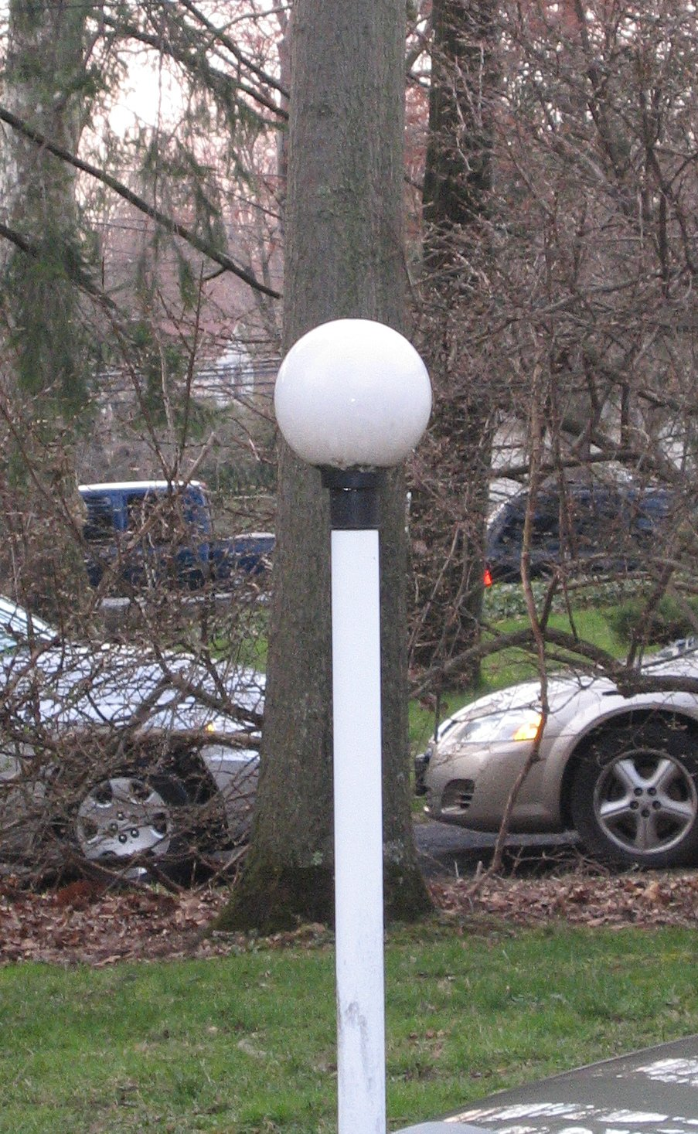
How Did We Get Here? (Cont’d)
Fixtures less than 50 percent efficient

Slide 30
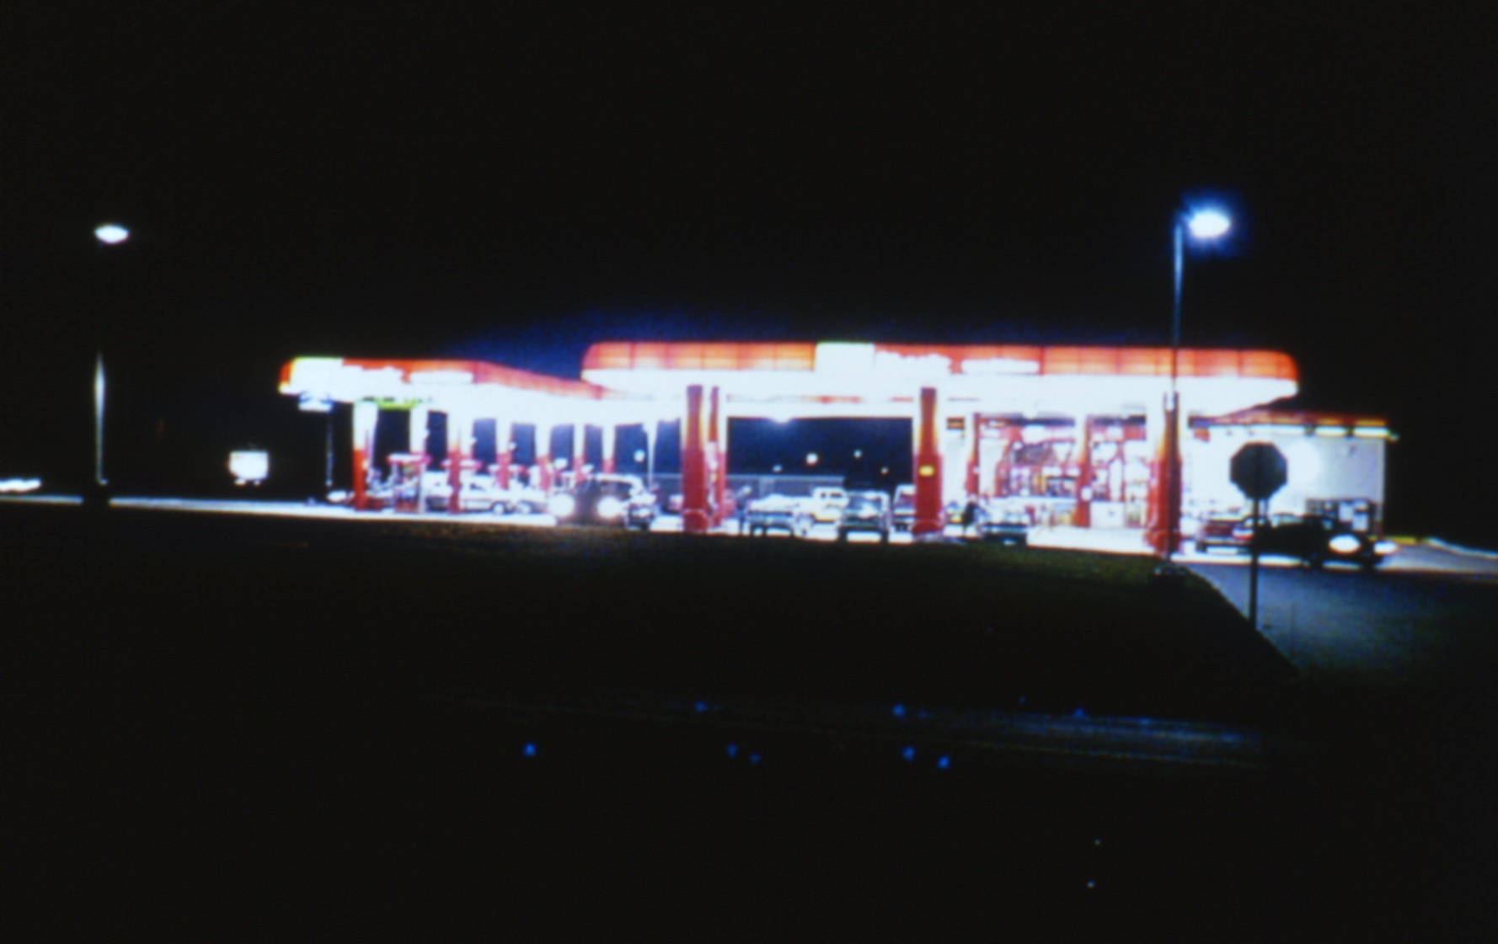
How Did We Get Here? (Cont’d)
Glare is being used as “advertising”

Slide 31
Impacts of Poor Outdoor Lighting Practices
Safety/Security
  Glare and deep shadows limit visibility
Social
  Aesthetic Blight - Visual Clutter
  Light trespass
  Visual comfort is lacking

Slide 32
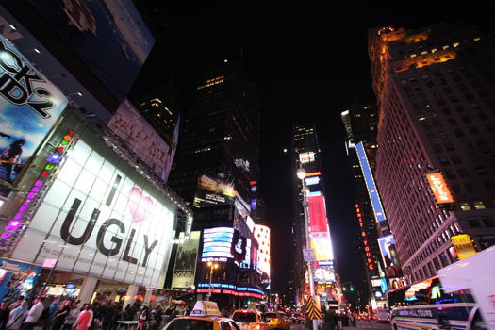
Visual Clutter

Slide 33
Impacts of Poor Outdoor Lighting Practices (Cont’d)
Economic
  Billions of energy dollars wasted on careless and excessive use of outdoor lighting
  An estimated $7.4 billion wasted annually in the U.S.
  Pennsylvania’s share is about $250 million per yr
    Approx. 2.5 billion kilowatt-hours
    Approx. 1.25 million tons if generated by coal (at 2000 kWh per ton)

Slide 34
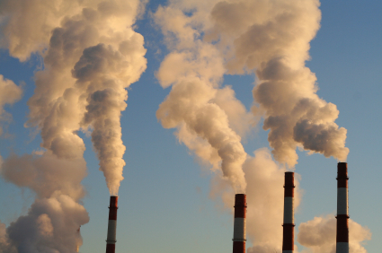

Slide 35
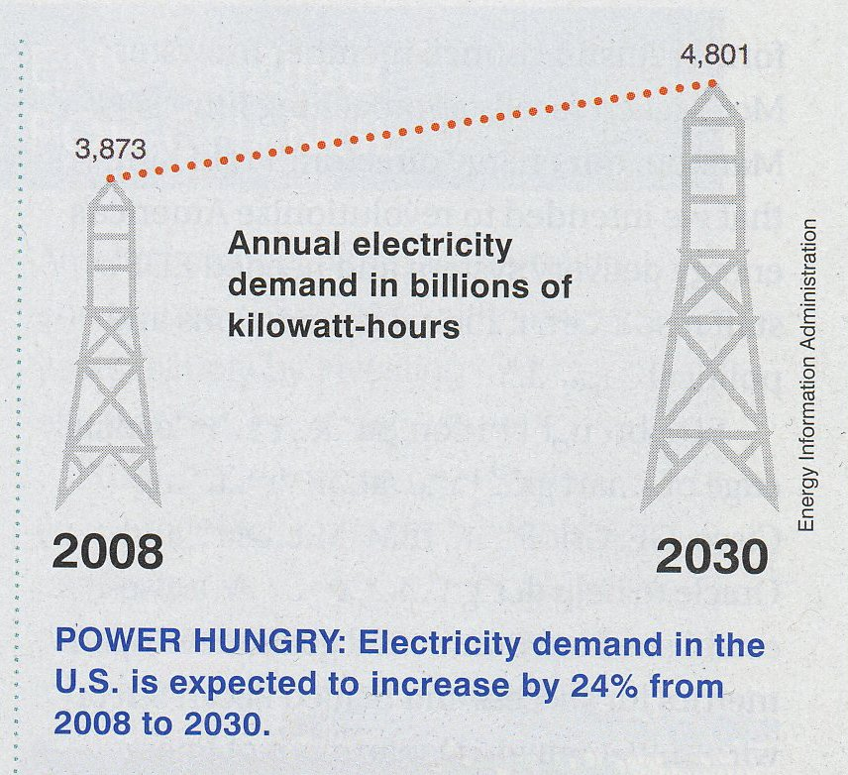

Slide 36
Impacts of Poor Outdoor Lighting Practices (Cont’d)
Human Health
  All living things are adapted to a daily cycle of sunlight and darkness due to the earth’s rotation – “plankton to primates”
  Daytime exposure to sunlight resets human “clock” via non-visual receptors in retina – “Circadian Rhythm“
  Melatonin produced mostly between midnight and dawn. Melatonin has been shown to be cancer-protective in humans
  Exposure to light both day and night can suppress melatonin production, particularly blue light (night shift workers)
  Intensity, spectrum, duration and timing – Int’l Space Station

Slide 37
Impacts of Poor Outdoor Lighting Practices (Cont’d)
Environmental
  Pollution from unnecessary electric power generation
  Negative impact on nocturnal animals and migratory birds
  Negative impact on plant life and pollinators
  Exposure to light at night can adversely affect human health (melatonin suppression)

Slide 38
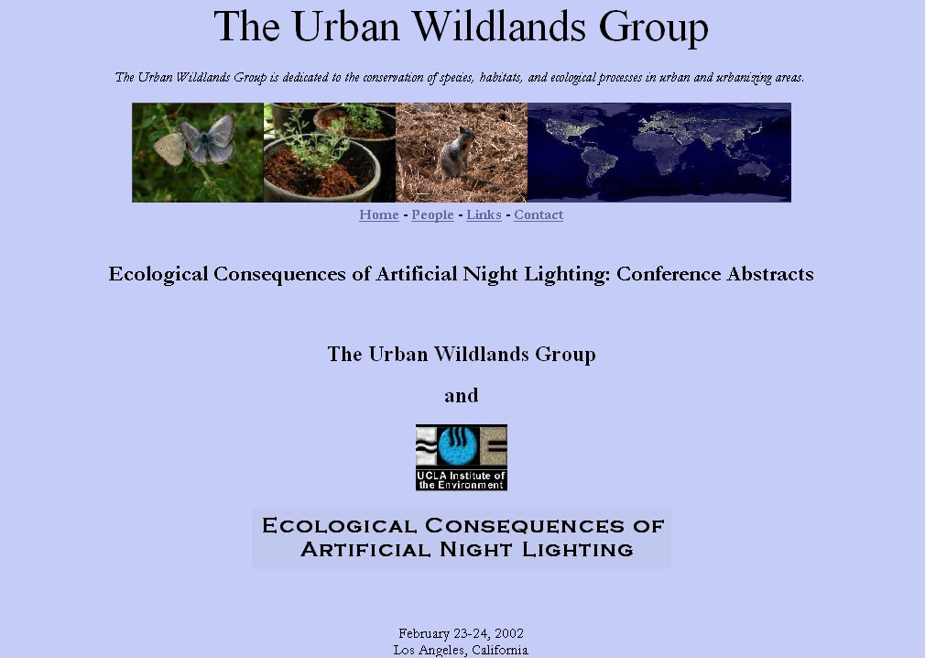
http://www.urbanwildlands.org/abstracts.html

Slide 39
Light Trespass Lawsuit - Pennsylvania
"Montgomery County (PA) Law Reporter"
Judge Honeyman, February 1, 1968 (page 142)
Hetzer et al v. Paparo et al
Paparo et al v. Hetzer et al
property located on Church Rd., Lafayette Hill

Slide 40
Light Trespass Lawsuit - Pennsylvania
The test for nuisance applied in Hetzer v. Paparo was that if the intensity of the light shining from the adjoining land is strong enough to disturb a person of ordinary sensibilities, it is a nuisance and must be corrected.
The court did not recognize any right to protection for persons who were hypersensitive to outdoor lighting.

Slide 41
Light Trespass Lawsuit - Colorado
Cash vs. Emich d.b.a. Elway Chrysler Jeep West & Elway Subaru West, Golden, Colorado
Colorado Court of Appeals in Denver. The appealed ruling was announced in September, 2006

Slide 42
Light Trespass Lawsuit - Colorado
The court held that the lights were an actionable nuisance. The jury also found that the defendants (the car dealerships) were creating, maintaining and/or allowing a nuisance to exist.

Slide 43
Light Trespass Lawsuit - Colorado
Paraphrasing, the court held that the laws are sensitive to property owners rights to use and enjoy their private property, without having to close blinds or curtains on their windows to accommodate a business interest (the bright lights).

Slide 44
Light Trespass Lawsuit - Colorado
lawsuit has set a new precedent for nuisance light.
relief from bright light that interferes with the use and enjoyment of their private property.

Slide 45
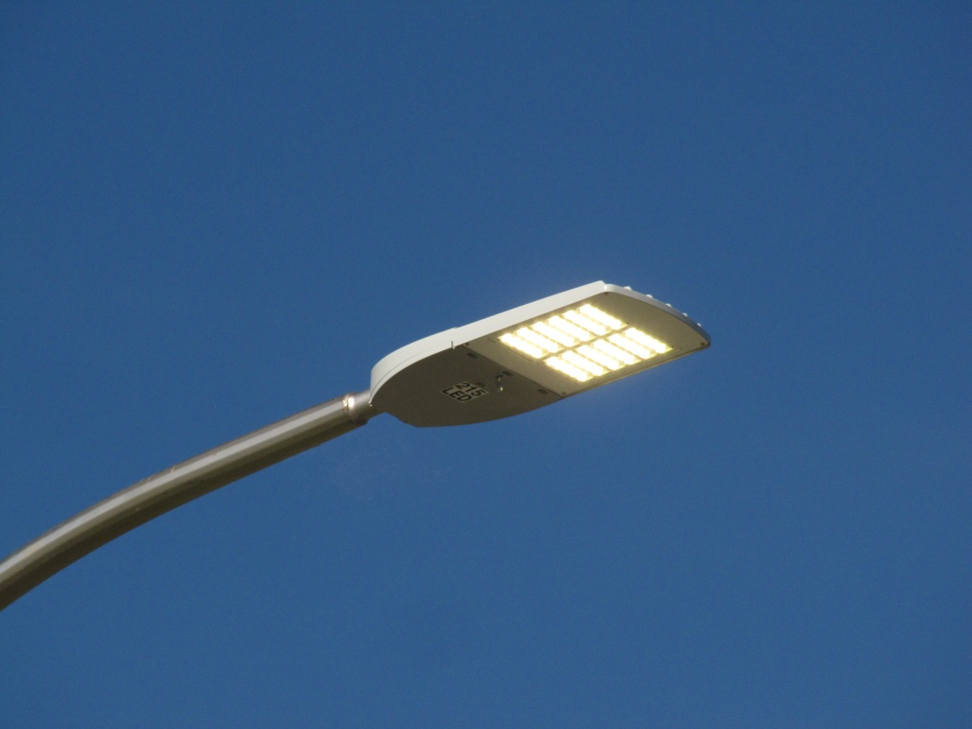
Light Emitting Diodes
We’re in an LED revolution…
Solid-state lighting has some advantages over conventional sources:
Long life
Energy efficiency
Reduced maintenance
No mercury
Inherently directional
Instant-on, dimmable
Tunable spectrum
Can be part of a digital infrastructure

Slide 46
Light Emitting Diodes
But:
Prone to glare: still must be shielded
Each emitter is like a bare bulb
Light output diminishes over time
- Electronic driver can fail
Still need to be cleaned
May still need replacement
  Lightning strikes
  Traffic accidents
  Storm damage

Slide 47
LED Choices
In addition to cost, safety and sustainability goals, LED sources are chosen based on qualities such as:
community acceptability, preference,
other aspects of aesthetics, color fidelity,
task performance, color discrimination,
object detection via color contrast…

Slide 48

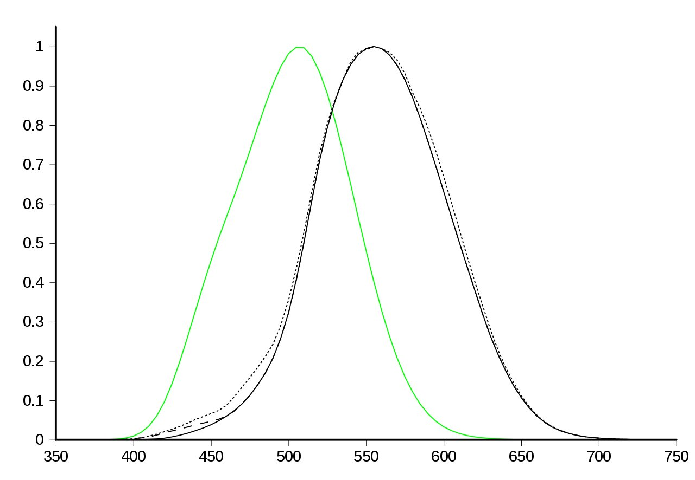
Human Vision
Human visual perception of brightness as a function of wavelength
Wavelength (nM)

Slide 49
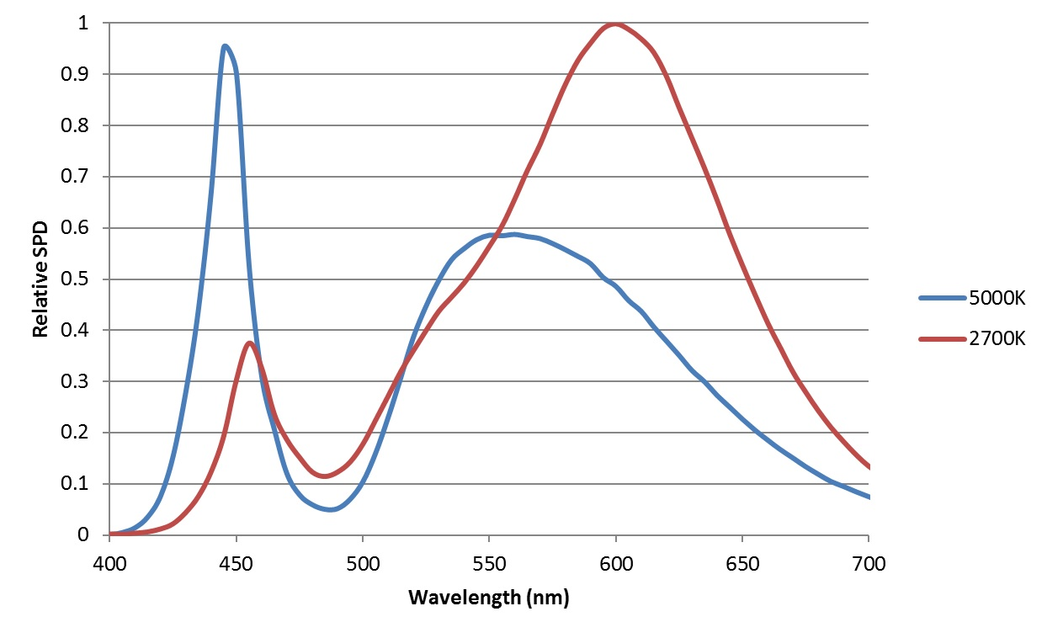
Spectral Power Distribution & CCT

Slide 50
Circadian Rhythm
- Circadian means "approximately daily".
- In addition to the circadian clock in our brains, every organ and tissue so far studied contains its own circadian clock, all regulated by the master clock in the brain.
- The master clock in the brain is set by the daily light/dark cycle of sunlight that comes from living on a rotating earth. - This cycle is present in all living things from plankton to primates.

Slide 51
Light as a “Stimulus”
- Light on the retina is a potent stimulus for regulating circadian, hormonal, and behavioral systems.
- In addition, light therapy is effective for certain affective disorders, sleep problems, and circadian rhythm disruption. In short, light acts like a drug.
- These biological and behavioral effects of light are influenced by distinct non-visual photoreceptors in the eye: melanopsin-containing intrinsically photosensitive Retinal Ganglion Cells (ipRGCs) in the retina, in addition to conventional rods and cones.
Notes:
The effect of light on humans is via a neural path from the retina to the suprachiasmatic nucleus (clock nucleus) to the thalamus and hypothalamus to the pineal gland (creates melatonin).

Slide 52
Resources
Illuminating Engineering Society (IES)
  the recognized technical authority on illumination
  communicate information on all aspects of good lighting practice
  over 100 publications including recommended practices on a variety of applications, design guides, technical memoranda, and publications on energy management and lighting measurement
  www.ies.org

Slide 53
Resources (Cont’d)
Lighting Research Center
at Rensselaer Polytechnic Institute, Troy, New York
http://www.lrc.rpi.edu/
World leading center for lighting research and education – pioneering research in solid-state lighting, light and health, transportation lighting, and energy efficiency

Slide 54
Resources (cont’d)
DarkSky International– formerly (IDA)
www.darksky.org Tucson, AZ
Est. 1988, educational, environmental 501(c)(3) nonprofit dedicated to protecting and preserving the nighttime environment and our heritage of dark skies through quality outdoor lighting.
With thousands of members in more than 70 countries, IDA is the leading authority concerning the problems and solutions related to light pollution.

Slide 55
Resources (Cont’d)
DesignLights Consortium - The DLC is a non-profit organization improving energy efficiency, lighting quality, and the human experience in the built environment. Collaborates with utilities, energy efficiency programs, manufacturers, lighting designers, building owners, and government entities to create rigorous criteria for lighting performance that keeps up with the pace of technology.
https://www.designlights.org/
Qualified Product List (QPL) and On-Demand Webinars

Slide 56
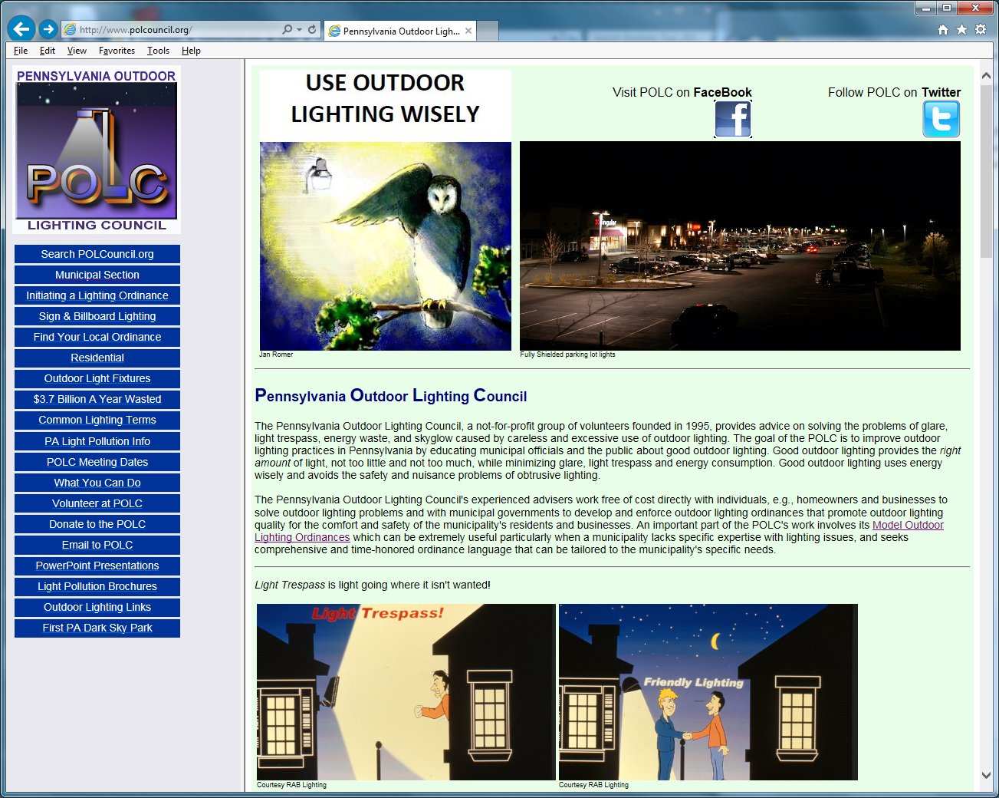

Slide 57
Recommendations
Improve Outdoor Lighting Practices
  Improves quality of life in our communities while saving money
  Promotes energy efficiency
Recognize Waste Outdoor Lighting as a significant environmental issue

Slide 58
Recommendations (Cont’d)
Promote the use of:
  Intelligent light controls, e.g. motion sensors, astronomic timers, programmable controllers
  Late night turn-off or dimming of all lighting except as needed for safety/security
  Fully shielded light fixtures to minimize glare light trespass, and wasted uplight

Slide 59
Conclusion
Don’t settle for bad lighting
An ordinance quantifies community expectations
Enact an effective ordinance and enforce it
Web - POLCouncil.org
Email - POLCouncil@PolCouncil.org

