Slide 1
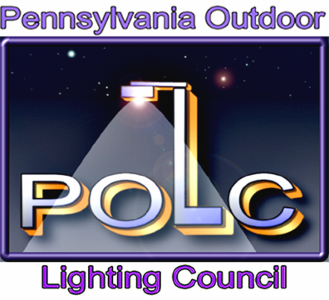
Outdoor Lighting Ordinances
Presented by
Pennsylvania Outdoor Lighting Council

Slide 2

TOPICS
Why should you have a lighting ordinance?
When should you have a lighting ordinance?
What is in an effective ordinance?
How to get an ordinance started, enacted and enforced?

Slide 3
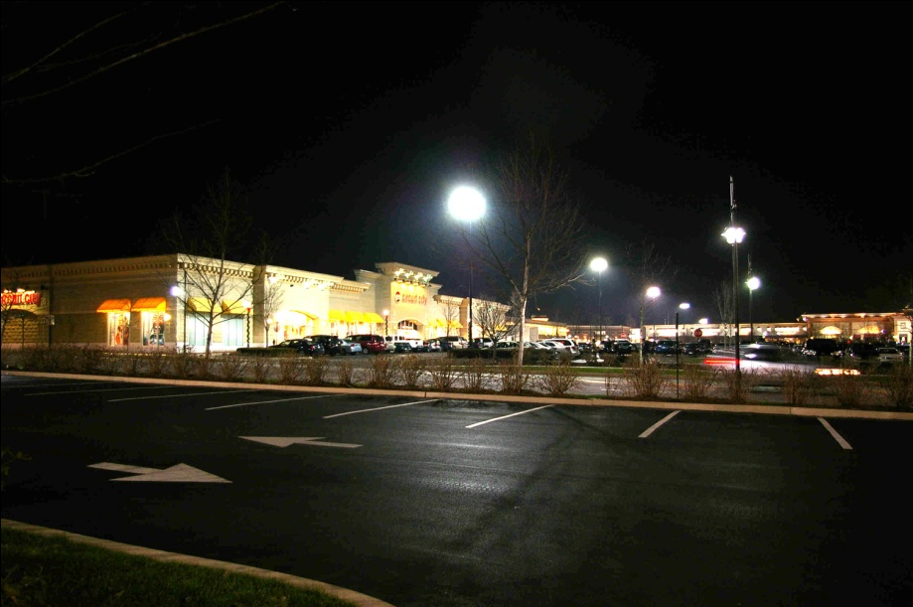
WHY AN ORDINANCE?
Truths
If a municipality doesn’t have an effective lighting ordinance and doesn’t think one is needed, it may be a glaring mistake.
Former Farm Pasture

Slide 4
WHY AN ORDINANCE?
“Oh, we already have a good ordinance.”
Zoning Ordinance
Amended 6/1/2009
Section 1115 – Lighting shall be arranged so that it does not reflect towards any public street or residential zoning district.

Slide 5
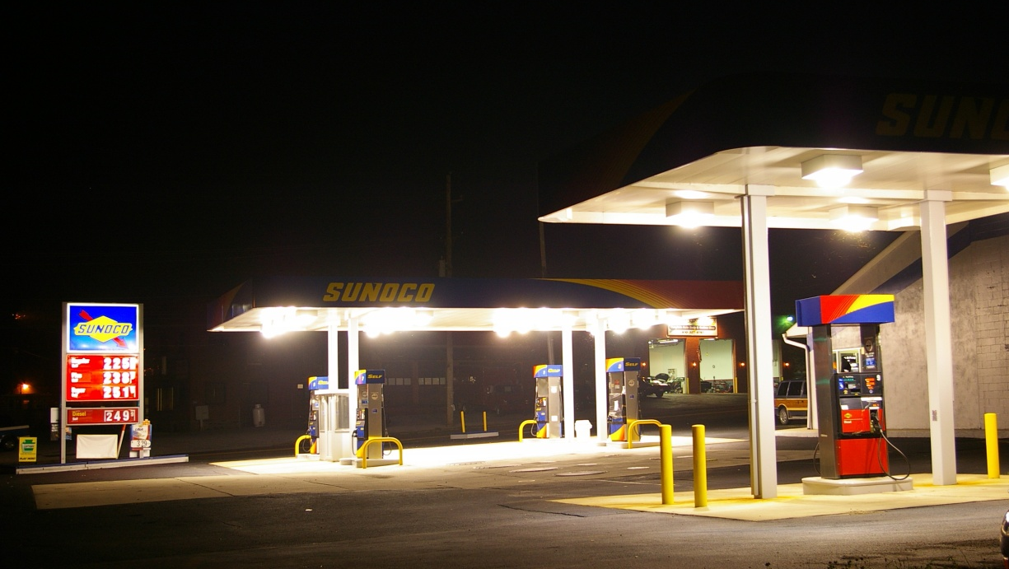
WHY AN ORDINANCE?
Truths
If a municipality doesn’t have an effective lighting ordinance, it can hope for the best, but should be prepared for the worst.

Slide 6

WHY AN ORDINANCE?
Truths
An application will not be covered by an ordinance passed after the application is filed.
If you don’t have an ordinance, you play by the developer’s rules.

Slide 7
ORDINANCE BENEFITS
A good lighting ordinance:
Prevents excessive and under lighting
Protects citizens, drivers, the environment and the night sky from glare and light pollution
Sends a clear message to applicants that bad lighting will not be tolerated.

Slide 8
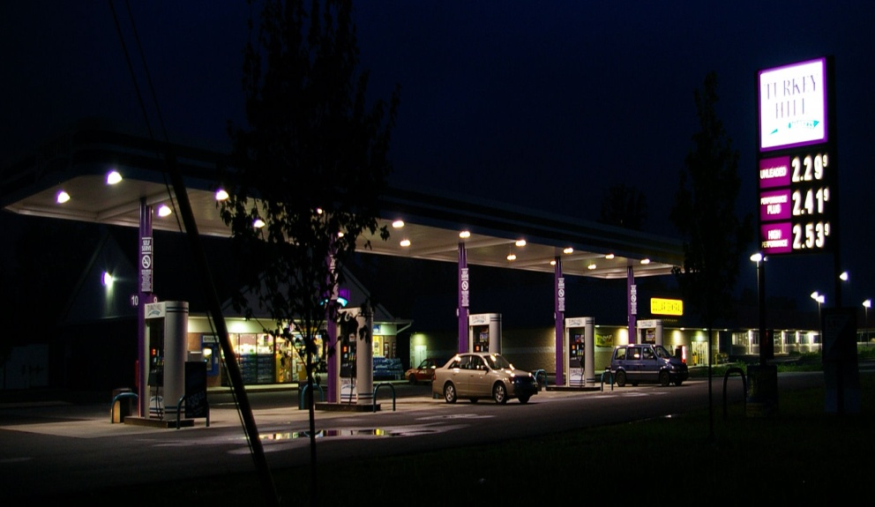
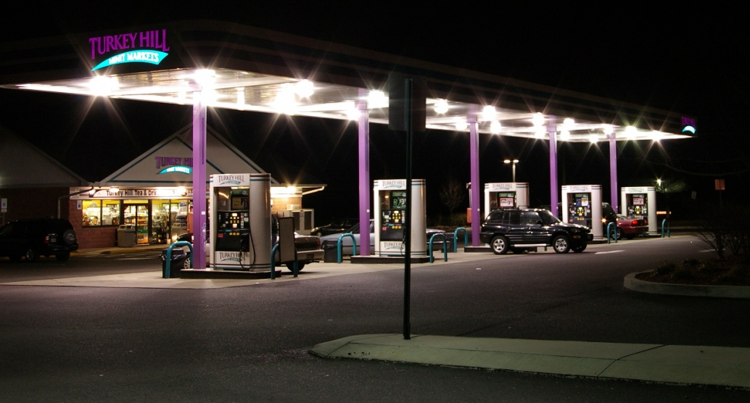
Prevents Surprises
ORDINANCE BENEFITS
What was promised
What they got

Slide 9
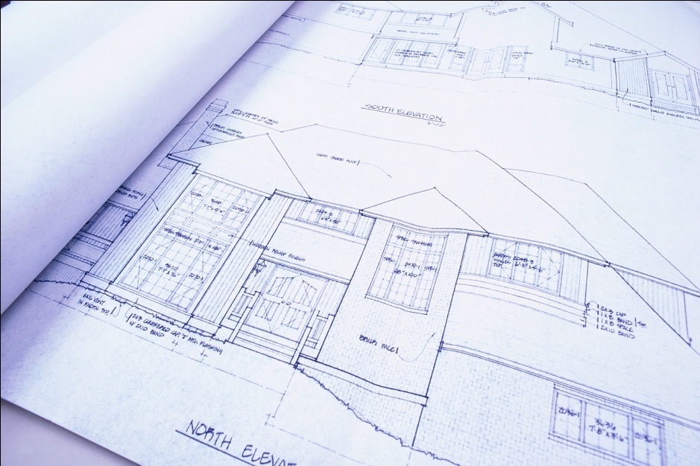
ORDINANCE BENEFITS
Requires that applicants provide complete information about proposed lighting, so ordinance compliance can be fully judged before application approval.

Slide 10
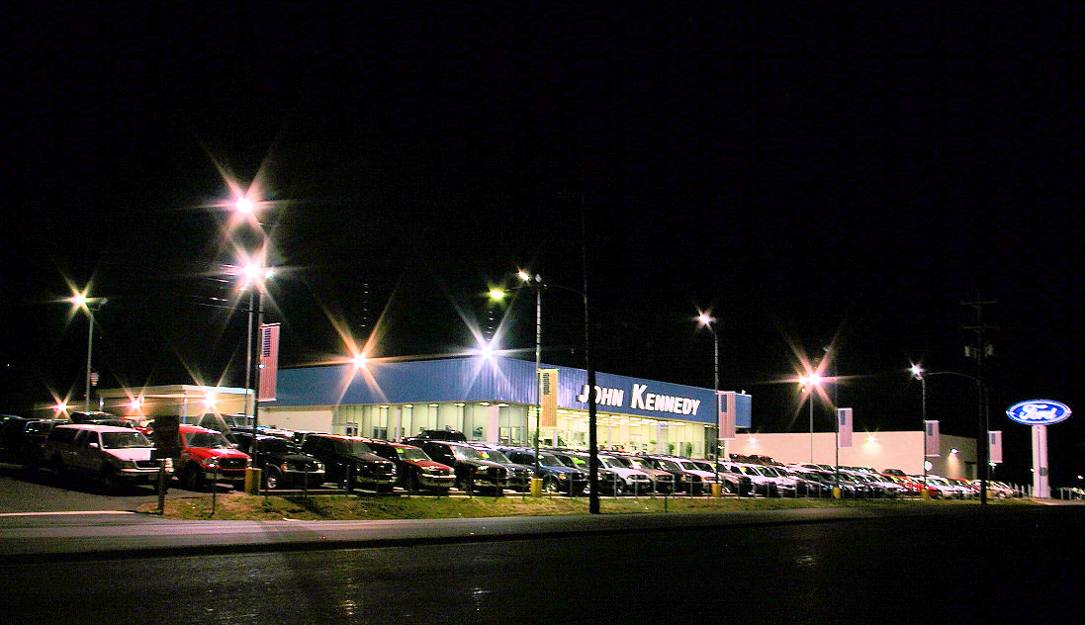
Provides Ability to Correct Existing Problems
ORDINANCE BENEFITS

Slide 11
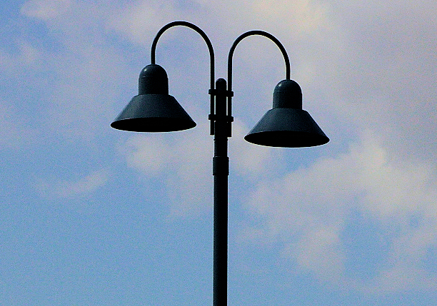
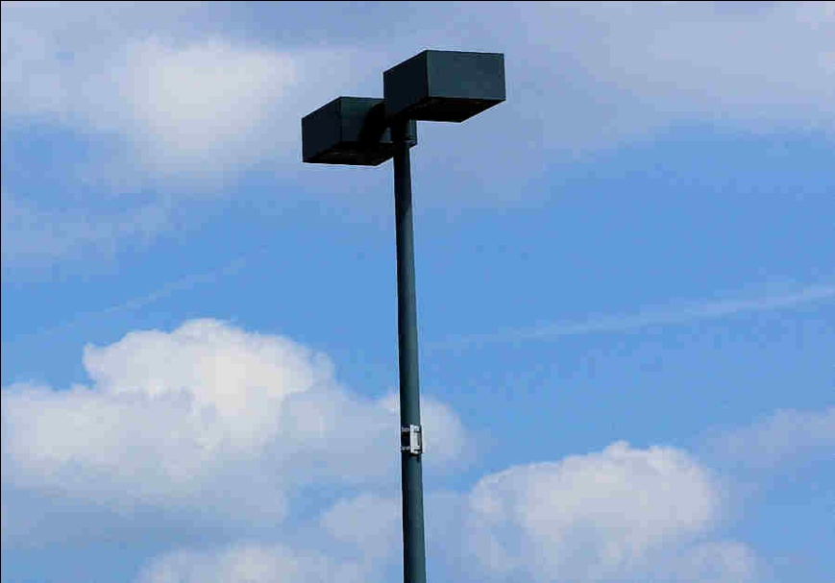
ORDINANCE ELEMENTS
Purpose, Scope and Exemptions
  What uses and lighting types covered
Requirements for:
  Allowed Fixture types, e.g., full cutoff

Slide 12
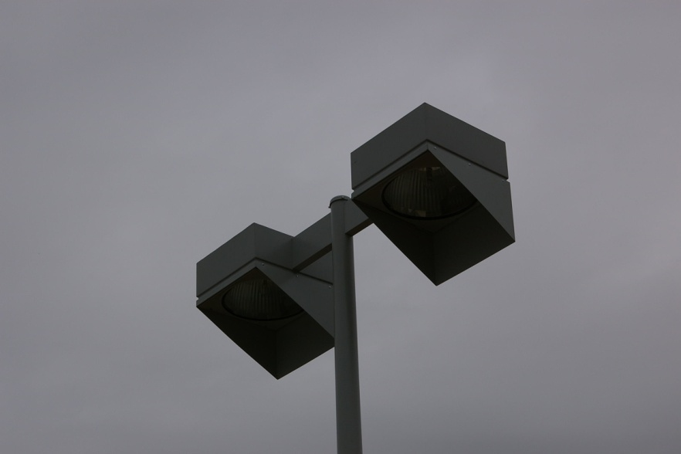
ORDINANCE ELEMENTS
Requirements for:
  Glare control, e.g., aiming, shielding, light trespass

Slide 13
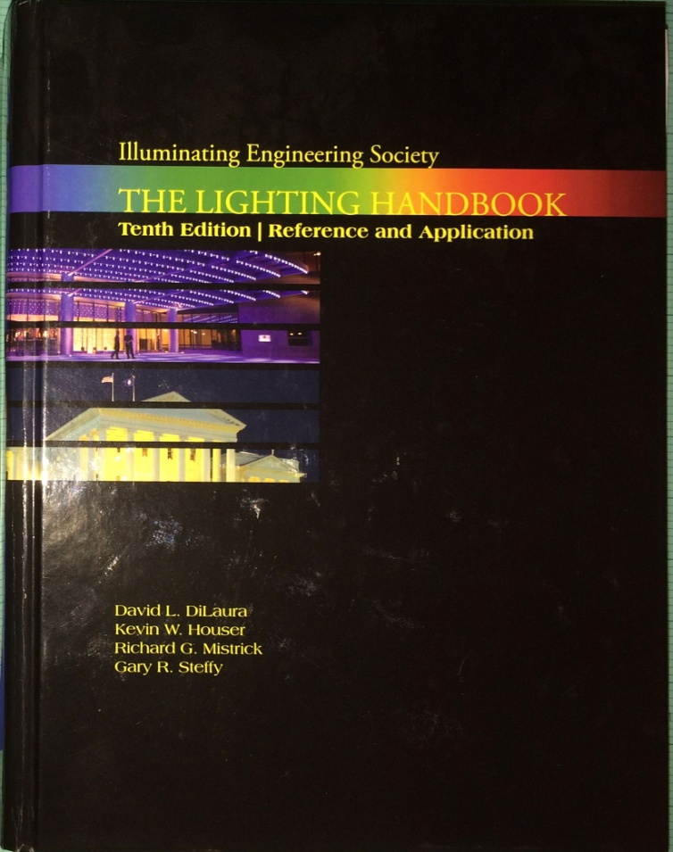
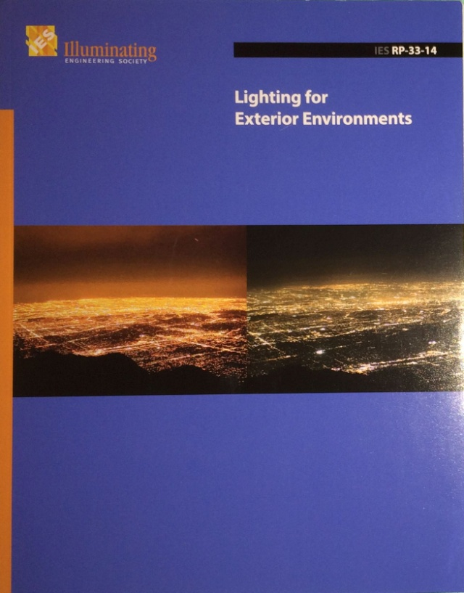
ORDINANCE ELEMENTS
    Lighting levels and uniformities per the
    Illuminating Engineering Society, IES
Notes:
IES = Illuminating Engineering Society

Slide 14
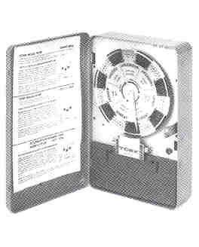
ORDINANCE ELEMENTS
Continued
  Max. allowed fixture mounting heights
  LED source max. color temperature
  Shut-off hours/how much security lighting
  Pole protection behind parking spaces
  Plan submission content

Slide 15
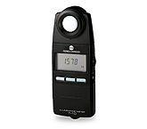
ORDINANCE ELEMENTS
Continued
  Dealing with post-approval substitutions
    How to handle attempts to substitute lighting equipment not on approved plan.
  Compliance verification/monitoring
    Right by municipality to visit site and verify installed lighting’s compliance with approved plans.
  Dealing with non-conforming lighting
    How to handle existing pre-ordinance lighting. Grandfather or require compliance after x years?

Slide 16

GETTING STARTED
Assign responsibility to shepherd process.
Don’t start from scratch. Use a proven ordinance model, and tailor to municipality’s needs.
PENNSYLVANIA OUTDOOR LIGHTING COUNCIL
MODEL LIGHTING ORDINANCE
For inclusion in
ZONING ORDINANCES
This model ordinance is intended to be installed as a section of the zoning ordinance covering all zoning districts. Requirements unique to a district should be included in that district’s section or in an overlay section.
Notes:
MLO

Slide 17
GETTING STARTED
Seek technical help where needed on lighting issues
  POLC can provide technical assistance
    Will proposed language still provide protection?
    Are there special needs?
Notes:
MLO

Slide 18
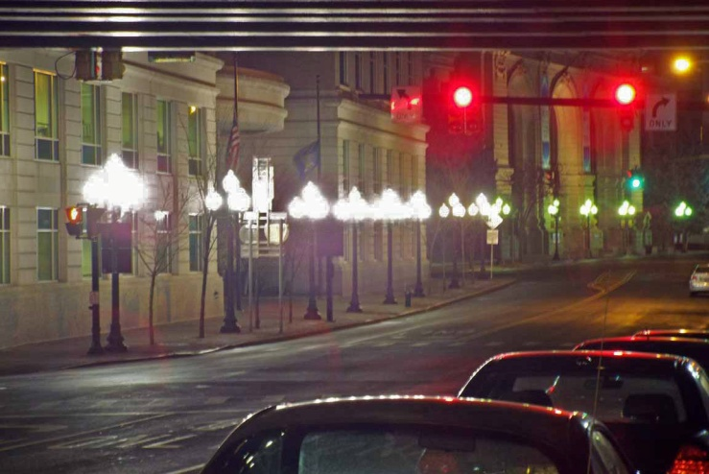
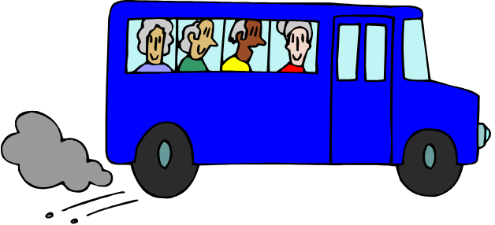
GETTING STARTED
Optional Steps to Consider
Convene group, get buy-in. Include elected officials, planning, EAC, zoning, police, municipal engineer, citizens.
Take field trips to find good and bad lighting examples.

Slide 19
WHERE TO PLACE?
Where should the lighting requirements be placed for optimum accessibility and commitment to their use?
Subdivision and Land Development Ordinance
?
Zoning Ordinance
?
Stand-Alone Ordinance
?
Notes:
Combination of ZO and S&LDO
No public hearing for standalone

Slide 20
WHERE TO PLACE?
SALDO
In SALDO?
Covers subdivision and land development applications but not all renovations, retrofits, building permits, construction and many small projects, e.g., gas stations, billboards.
ZHB and Code Enforcement don’t typically use SALDO
Notes:
Combination of ZO and S&LDO
No public hearing for standalone

Slide 21
WHERE TO PLACE?
CONTINUED
Zoning Ordinance
In Zoning?
ZHB/Code Enforcement Officer know and use every day.
Covers renovations and residential too
Supervisors do not have jurisdiction except in Conditional Use.
Notes:
Combination of ZO and S&LDO
No public hearing for standalone

Slide 22
WHERE TO PLACE?
CONTINUED
Stand-Alone Lighting Ordinance
Stand-Alone Document?
Often gets put on shelf, goes unused.
Typically not kept current
Circumvents county review and public hearing process.
Recommended only if municipality doesn’t have SALDO & ZO
Notes:
Combination of ZO and S&LDO
No public hearing for standalone

Slide 23
WHERE TO PLACE?
CONTINUED
SALDO
Zoning Ordinance
Best Choice
Put in ZO and cross-reference in SLDO
  Second best choice
Put parts appropriate to land development in SLDO and parts appropriate to zoning in ZO. (Naturally there will be some duplication.)
Notes:
Combination of ZO and S&LDO
No public hearing for standalone

Slide 24
WHERE TO PLACE IN ORDINANCE?
Sprinkle in each zoning district section, or create a separate lighting section?
Create a separate lighting section to cover all districts.
(Good lighting is good lighting regardless of district.)
Recommended
Notes:
Combination of ZO and S&LDO
No public hearing for standalone

Slide 25
WHERE TO PLACE IN ORDINANCE?
Only put very unique requirements in applicable zoning or overlay district section
Environmental Overlay District
1. Lighting shall not exceed 0.5 fc
2. Lighting shall be low voltage
3. Lighting shall be aimed straight down
4. All lighting shall be extinguished by 9 pm
Notes:
Combination of ZO and S&LDO
No public hearing for standalone
7.1. LZ0: No ambient lighting?. Areas where the natural environment will be seriously and adversely affected by lighting. Impacts include disturbing the biologicalcycles of flora and fauna and/or detracting from human enjoyment and appreciation of the natural environment. Human activity is subordinate in importance to nature. The vision of human residents and users is adapted to the darkness, and they expect to see little or no lighting.
7.2. LZ1: Low ambient lighting?. Areas where lighting might adversely affect flora and fauna or disturb the character of the area. The vision of human residents and users is adapted to low light levels. Lighting may be used for safety and convenience but it is not necessarily uniform or continuous. After curfew, most lighting should be extinguished or reduced as activity levels decline.
7.3. LZ2: Moderate ambient lighting?. Areas of human activity where the vision of human residents and users is adapted to moderate light levels. Lighting maytypically be used for safety and convenience but it is not necessarily uniform or continuous. After curfew, lighting may be extinguished or reduced as activity levels decline.
7.4. LZ3: Moderately high ambient lighting?. Areas of human activity where the vision9of human residents and users is adapted to moderately high light levels. Lighting is generally desired for safety, security and/or convenience and it is often uniform and/or continuous. After curfew, lighting may be extinguished or reduced in most areas as activity levels decline.

Slide 26

GETTING IT PASSED
Get county review and hold public hearings
Strive to hold the line but be prepared for compromise (half a loaf)
Educate and convince before compromise
Don’t let the process die

Slide 27
ENFORCEMENT
An unenforced ordinance is valueless
Arrange for training of key players
Have tools available, e.g., light meter.

Slide 28
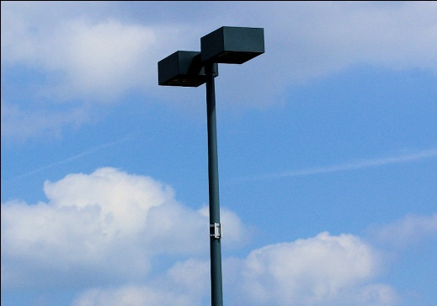
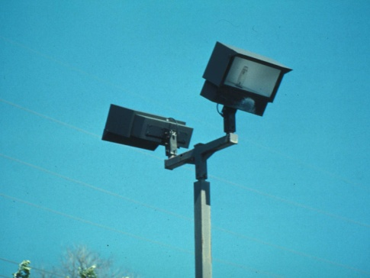
ENFORCEMENT
Lighting plans are unique. What is approved during SALDO review process seldom makes it to the electrical plans.
The architect, EE, GC and EC enter!
As Approved
As Installed
Notes:
General Contractor – Electrical Contractor

Slide 29
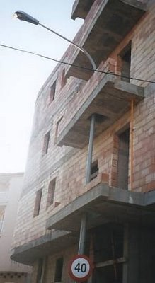
ENFORCEMENT
The architect, EE, GC and EC enter!
Approved civil land development plans
containing approved lighting info are
typically ignored by architect and EE.
EE designs per architectural plans and electrical contractor installs per EE plans, (maybe).
Result? Anybody’s guess.

Slide 30
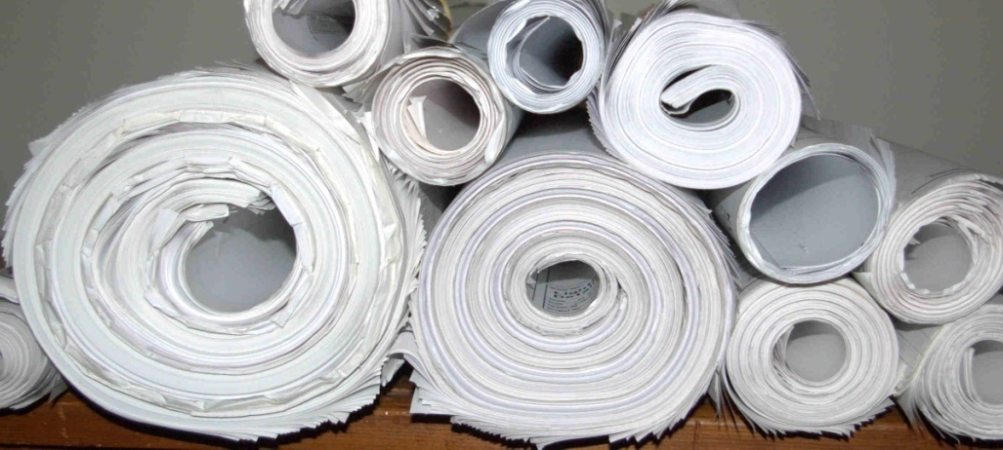
ENFORCEMENT
That’s why Building Permit lighting plans must be carefully reviewed for conformance with approved Land Development Plans, but seldom are.
Hmmm, Where are the Lighting Plans?

Slide 31
ENFORCEMENT
Reviewing Submitted Plans
Plan Review Check List
OK
Illuminance Levels a
Fixture Design a
Fixture Mounting Height a
Pole Protection a
Automatic Control a
Shut-off Time a
Security Lighting a
Required Plan Notes a
Light Trespass a
Complete Plan Content a

Slide 32
ENFORCEMENT
Developer needs to be made aware during land development that there will be charges for complete construction surveillance.
Section 509 of the MPC provides authority for municipalities to establish financial security agreement with the developer.
Financial Security Agreement
An agreement between the Township of Penn and Environmental Disaster Developers
Suburban Shopping Center
09/28/2012
Notes:
MPC = Municipalitys Planning Code

Slide 33

ENFORCEMENT
Municipalities with a reputation for not adequately monitoring construction often become a target of developers who do not intend to follow approved plans.

Slide 34
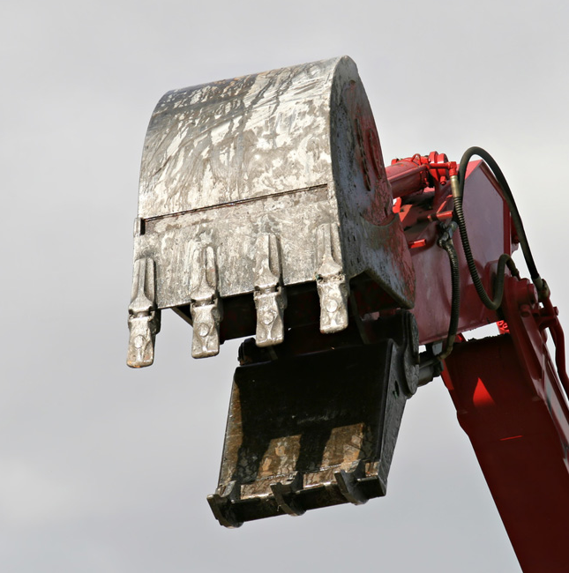
ENFORCEMENT
Undiscovered mistakes made during construction often come back to bite a municipality in the future

Slide 35

CONCLUSIONS
Check your ordinance for adequacy
Start the upgrade now, don’t wait for an unpleasant lighting surprise
Assign the task to an “insider” who cares and will see it through
Get competent technical help
Use it and enforce it!

Slide 36
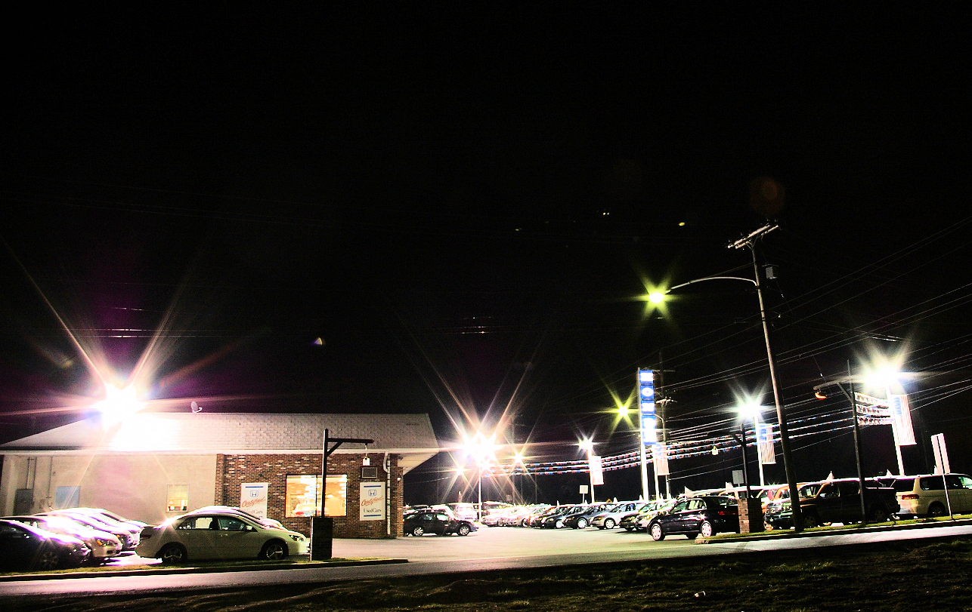
CONCLUSIONS
Don’t Let This Happen in Your Township

Slide 37
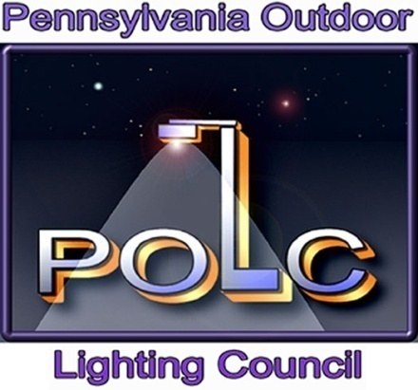
POLC Can Help You
Craft an Effective Lighting Ordinance

Slide 38
POLC
A non-profit group of volunteers that has helped over 40 municipalities and planners create effective lighting ordinances.
We can help you tailor an ordinance to meet your municipality’s specific needs

Slide 39
Some Enacted POLC Ordinances
Pennsylvania Townships
Amity
Bishop
Birmingham
Butler
Cornwall Borough
Douglass, Montco
East Bradford
East Coventry
East Nantmeal
East Pikeland
East Vincent
East Whiteland
Exeter
Highland
Limerick
London Grove
Maidencreek
Marlborough
New London
North Coventry
Northampton
Plumstead
Robeson
Schuylkill
South Coventry
St. Lawrence Borough
Tilden
Tinicum
Union
Upper Dublin
Upper Merion
Upper Uwchlan
Uwchlan
Valley
Wallace
Warwick
West Brandywine
West Pikeland
Westtown
West Vincent
West Whiteland
Willistown

Slide 40
Contact Information
Email: johnsonb52@comcast.net
Website: www.POLCouncil.org
Call: 215-542-9359 Barry Johnson
Website has much helpful information, including model lighting ordinances ready for tailoring to your specific needs.
This PowerPoint is on website if you want to show it to others in your municipality.

Slide 41

THANK YOU!
Pennsylvania Outdoor Lighting Council

