Slide 1
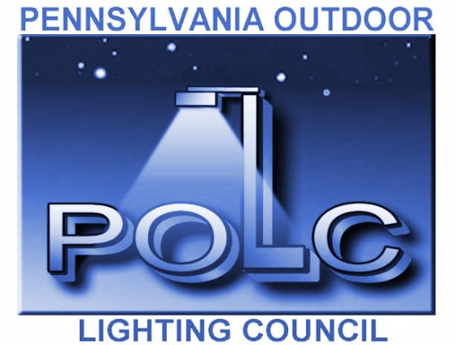
Outdoor Lighting
Planning Issues for Municipalities
presented by
Pennsylvania Outdoor Lighting Council

Slide 2
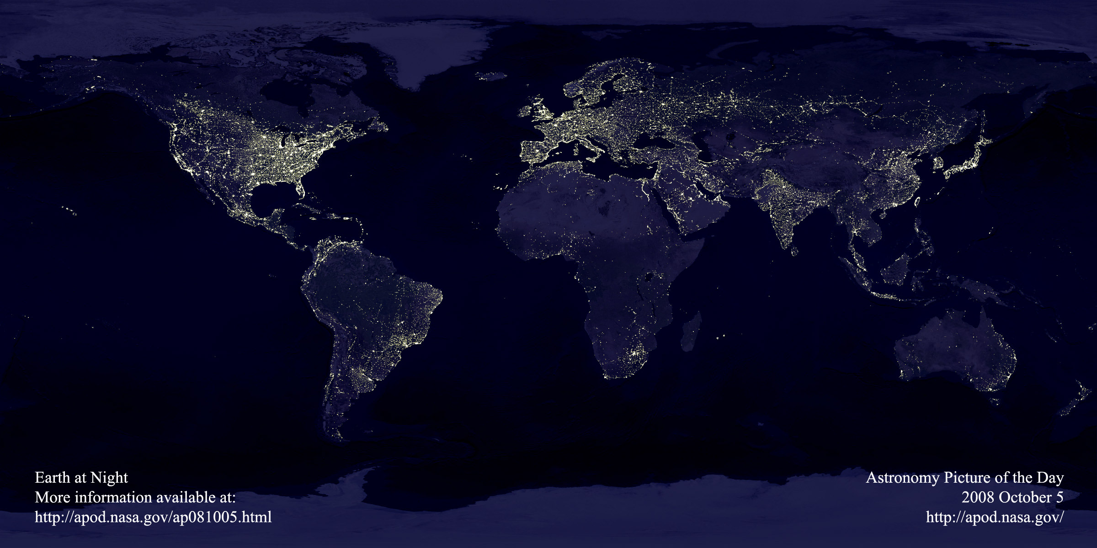
Outdoor Lighting Trends
Light pollution and billions of dollars of wasted energy

Slide 3
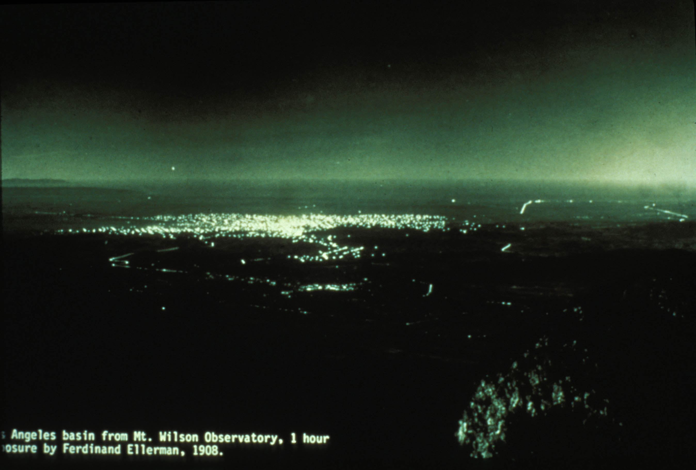
LA Basin 109 Years Ago

Slide 4
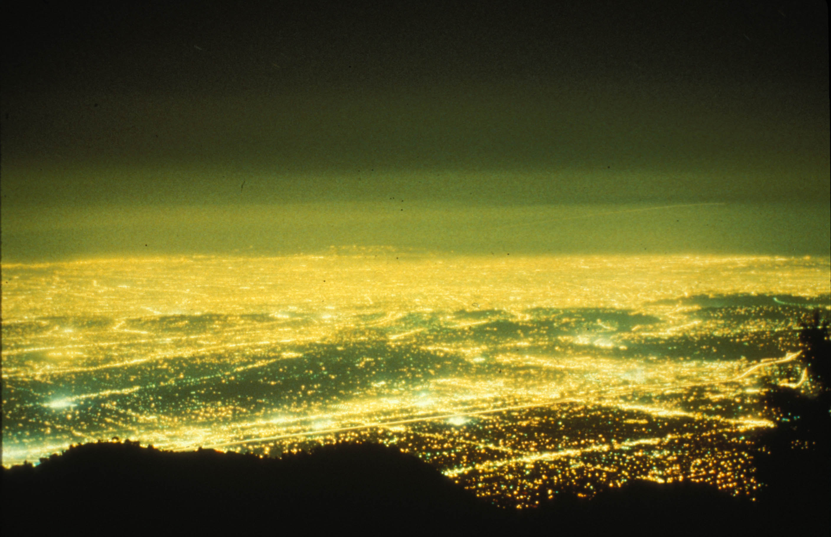
LA Basin 100 Years Later

Slide 5
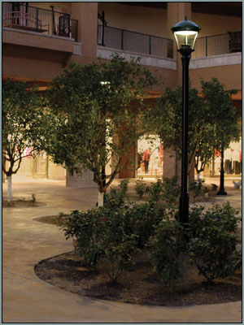
Why is good outdoor lighting important?
Good outdoor lighting is a community asset
Enhances safety and sense of security
Provides visibility for nighttime activities

Slide 6
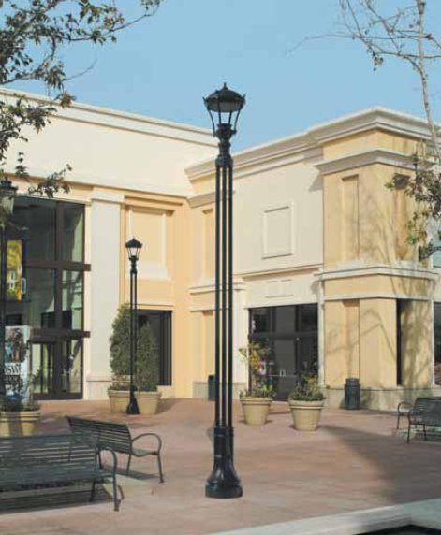
Why is good outdoor lighting important?
Strengthens the themes and goals of the community while highlighting its amenities
Communicates a positive visual image of the community, and visual order

Slide 7
The Downside
Careless and excessive use of light at night can be detrimental:
Glare – too much light in our eyes – nuisance, discomfort, loss of visibility
Light Trespass – light going where it isn’t wanted
Energy waste – uplight, when or where it’s not needed
Adverse effects on human health – melatonin suppression
Adverse effects on nocturnal animals – breeding and feeding
Urban skyglow – natural beauty of the night sky largely lost

Slide 8
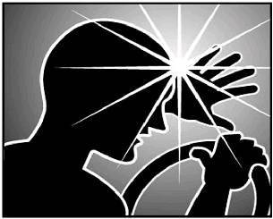
Glare
Good lighting aims and shields the source to prevent “glare.”
“Glare is light that causes annoyance, discomfort or loss in visibility

Slide 9
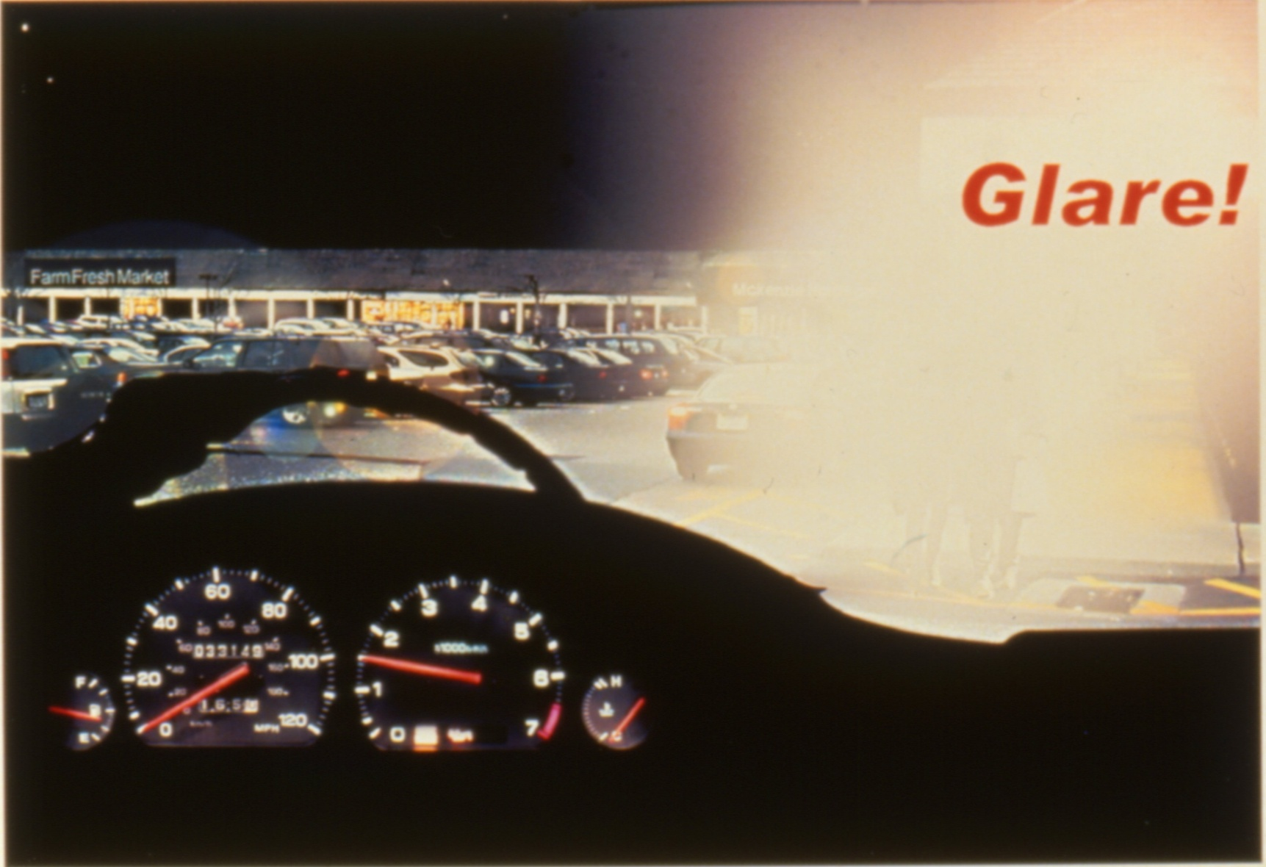
Glare

Slide 10
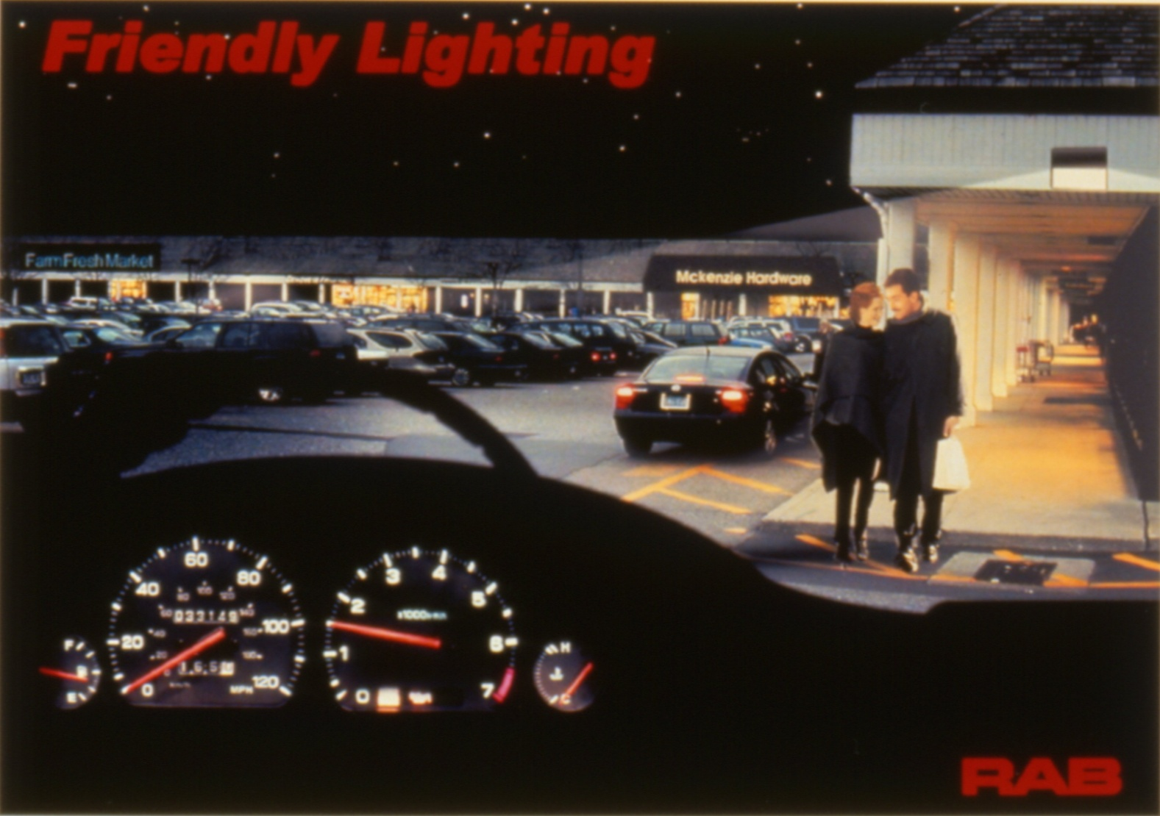
Glare Under Control

Slide 11
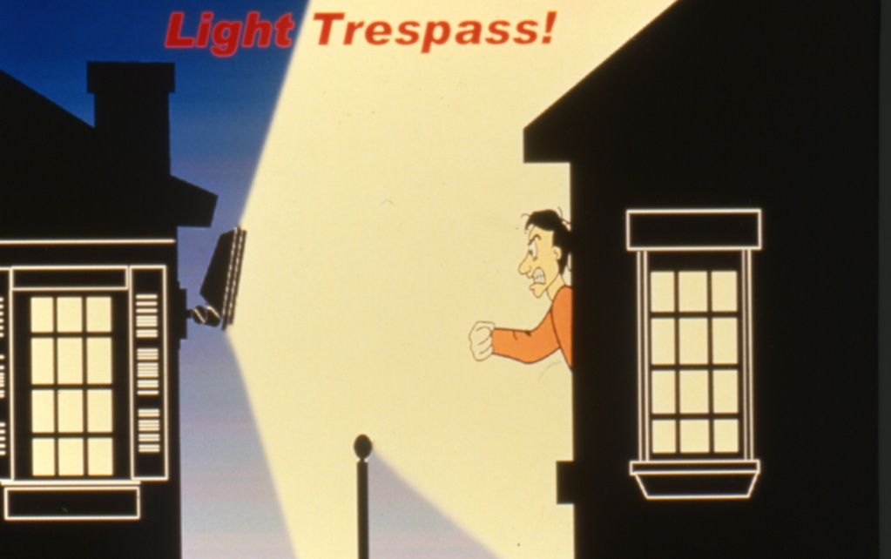
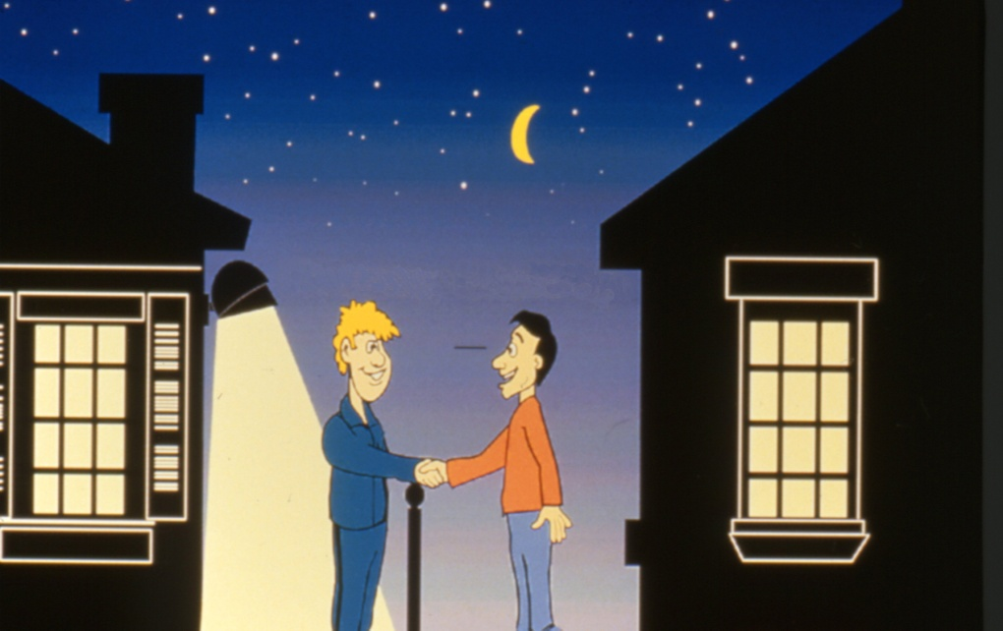

Light Trespass
Good lighting means placing the light only where it’s needed or is wanted, to prevent light trespass and sky glow.
Courtesy RAB Lighting
Courtesy RAB Lighting

Slide 12
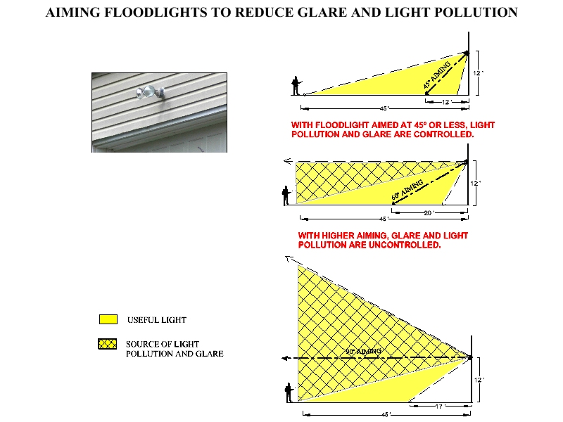

Slide 13
Goals of Good Outdoor Lighting
Optimize visibility at night
Minimize glare
Minimize light trespass
Minimize energy consumption
Minimize impact on the environment

Slide 14
Goals of Good Outdoor Lighting
- Lighting should create the set of conditions where our visual system can work efficiently.
- We see objects by reflected light and by contrast.

Slide 15
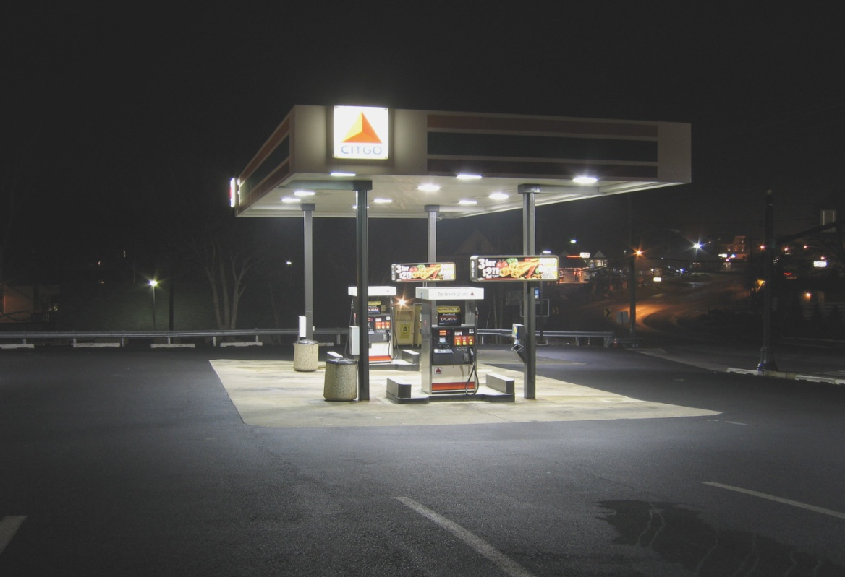
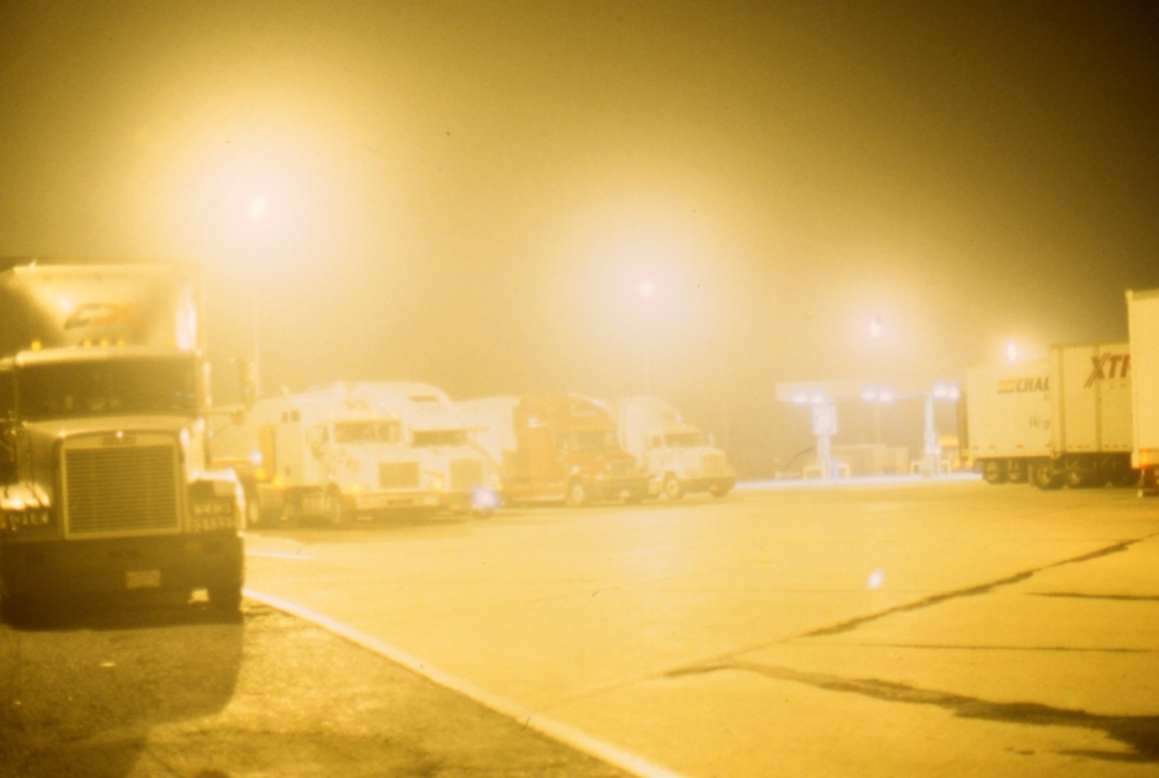
The Good and the Bad

Slide 16
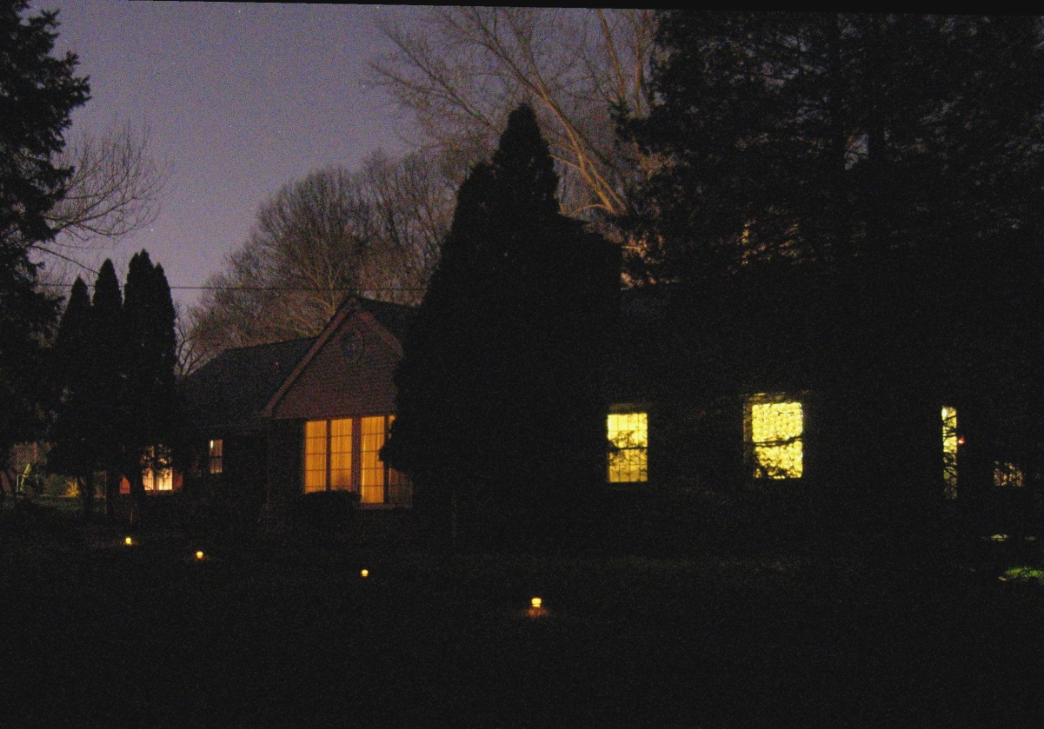
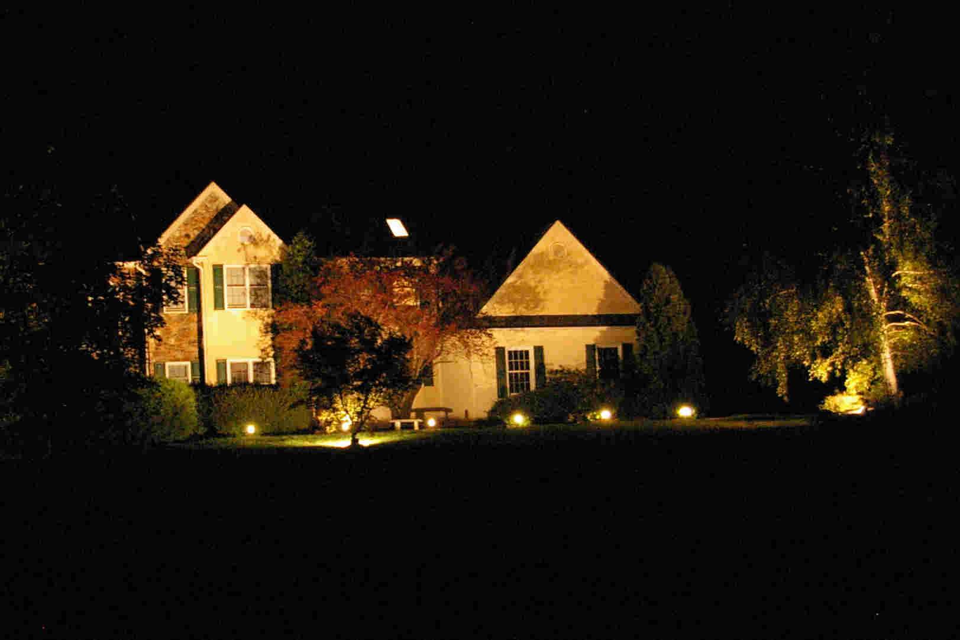
The Good and the Bad

Slide 17
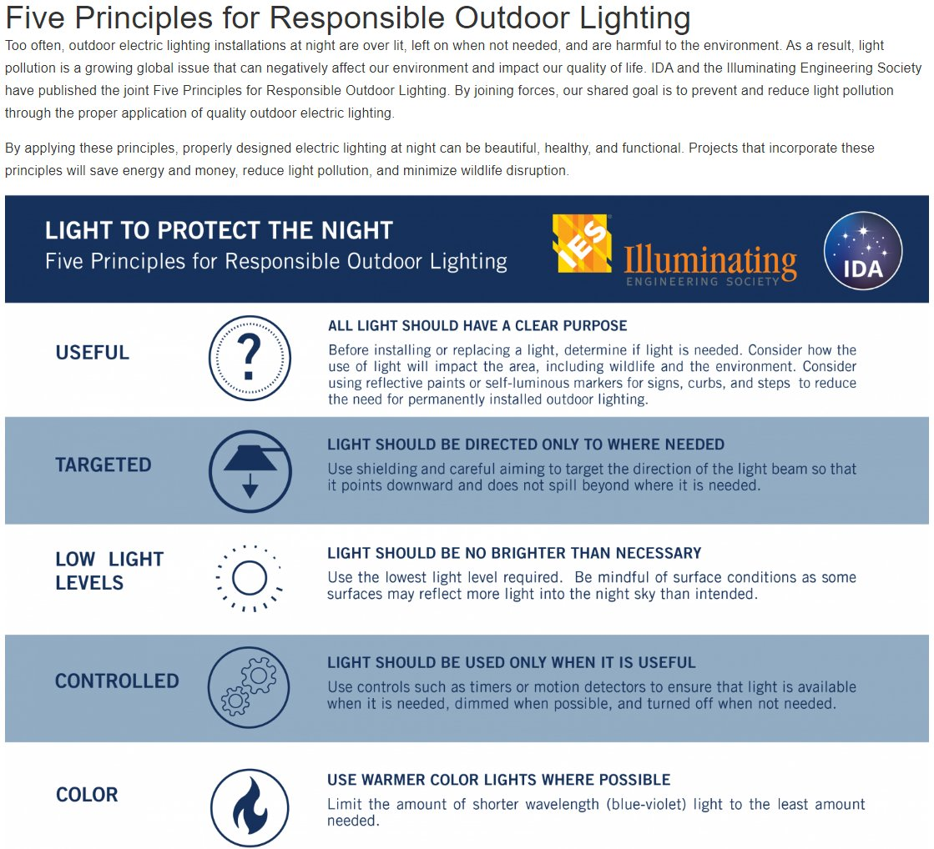

Slide 18
Today’s Situation
Too much money and energy are wasted in providing bad outdoor lighting
“Bad” lighting causes glare, and has too much or too little light for the outdoor seeing task
Most people are unaware that much of our outdoor lighting fails to follow recognized good lighting practices

Slide 19
Common Myths of Outdoor Lighting
“More light means better visibility.”
  If more light also means more glare, then visibility can actually be reduced. Glare is never helpful for visibility.
  Lighting quality is as important to visibility as lighting quantity.

Slide 20
Myths of Outdoor Lighting (Cont’d)
“More light means more security.”
  Poorly executed security lighting that creates glare and deep shadows can reduce visibility and actually aid criminals.
  Bright lighting can give an illusion of security. People can be induced to take risks that are not really justified by the overall situation.

Slide 21
Myths of Outdoor Lighting (Cont’d)
The Myth: “Security Lighting will reduce crime in urban outdoor areas.”
  A 1997 National Institute of Justice report to Congress said, “- - the effectiveness of lighting [as a crime deterrent] is unknown.” Results are mixed. We can have very little confidence that improved lighting prevents crime, particularly since we do not know if offenders use lighting to their advantage.”

Slide 22
Myths of Outdoor Lighting (Cont’d)
“We may speculate that lighting is effective in some places, ineffective in others, and counter productive in still other circumstances. The problematic relationship between lighting and crime increases when one considers that offenders need lighting to detect potential targets and low-risk situations (Fleming and Burrows 1986). Consider lighting at outside ATM machines, for example. An ATM user might feel safer when the ATM and its immediate surrounding area are well lit. However, this same lighting makes the patron more visible to passing offenders. Who the lighting serves is unclear.”

Slide 23
National Institute of Justice study, Feb., 1997
PREVENTING CRIME:
WHAT WORKS, WHAT DOESN'T, WHAT'S PROMISING
A REPORT TO THE UNITED STATES CONGRESS
Prepared for the National Institute of Justice
by Lawrence W. Sherman, Denise Gottfredson, Doris MacKenzie, John Eck, Peter Reuter, and Shawn Bushway
Department of Criminology and Criminal Justice
University of Maryland

Slide 24
How Did We Get Here?
Municipal codes have not kept pace with today's lighting technology, needs and practices
Municipalities have comprehensive building codes & electrical codes, but too few have an effective outdoor lighting ordinance
Electrical contractors have not gotten the word: GLUT =
Glare, Light Trespass, Uplight, Too much light

Slide 25
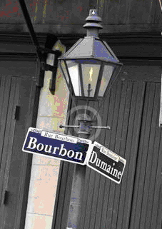
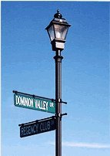
How Did We Get Here? (Cont’d)
We have yesterday’s fixtures with today’s more powerful light sources, producing much more glare.

Slide 26
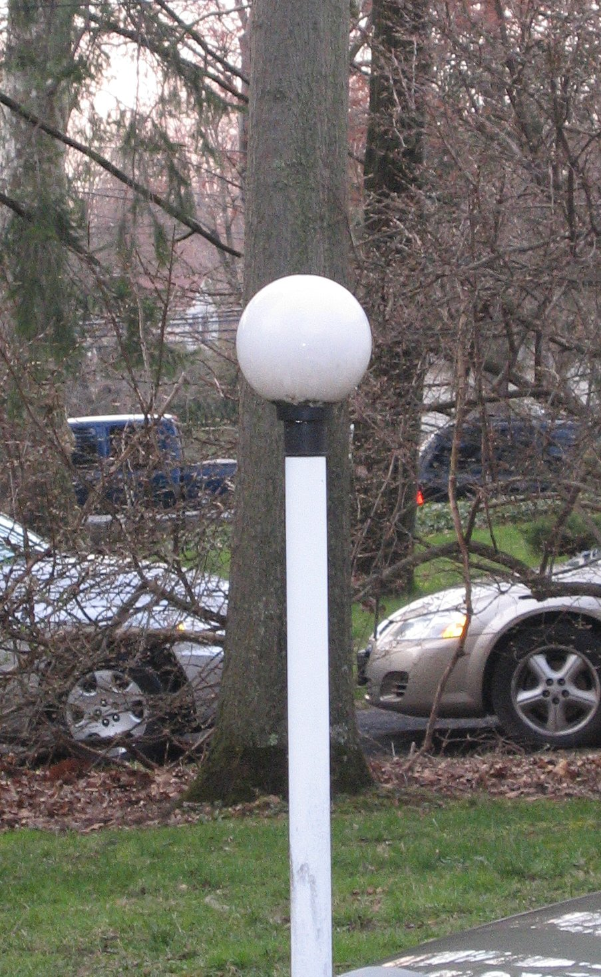
How Did We Get Here? (Cont’d)
Fixtures less than 50 percent efficient

Slide 27
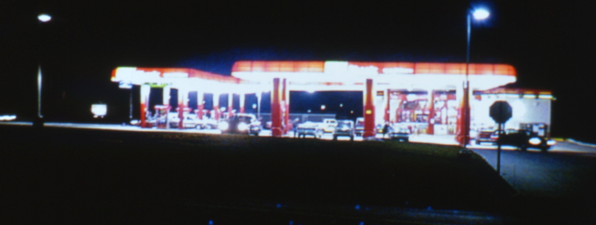
How Did We Get Here? (Cont’d)
Glare is being used as “advertising”

Slide 28
Impacts of Poor Outdoor Lighting Practices
Safety/Security
  Glare and deep shadows limit visibility
Social
  Aesthetic Blight - Visual Clutter
  Light trespass
  Visual comfort is lacking

Slide 29
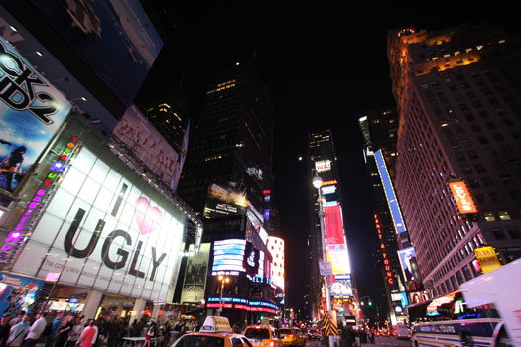
Visual Clutter

Slide 30
Impacts of Poor Outdoor Lighting Practices (Cont’d)
Economic
  Billions of energy dollars wasted on careless and excessive use of outdoor lighting
  An estimated $6.0 billion wasted annually in the U.S.
  New Jersey’s share is about $165 million per yr
    Approx. 1.5 billion kilowatt-hours
    750 thousand tons of coal (at 2000 kWh per ton)

Slide 31
Impacts of Poor Outdoor Lighting Practices (Cont’d)
Environmental
  Pollution from unnecessary electric power generation
  Negative impact on nocturnal animals and migratory birds
  Negative impact on plant life
  Exposure to light at night can adversely affect human health (melatonin suppression)

Slide 32
Impacts of Poor Outdoor Lighting Practices (Cont’d)
Human Health
  All living things are adapted to a daily cycle of sunlight and darkness due to the earth’s rotation – “plankton to primates”
  Daytime exposure to sunlight resets human “clock” via non-visual receptors in retina – “Circadian Rhythm“
  Melatonin produced mostly between midnight and dawn. Melatonin has been shown to be cancer-protective in humans
  Exposure to light both day and night can suppress melatonin production, particularly blue light (night shift workers)
  Intensity, spectrum, duration and timing – Int’l Space Station

Slide 33
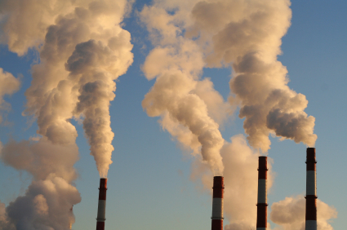

Slide 34
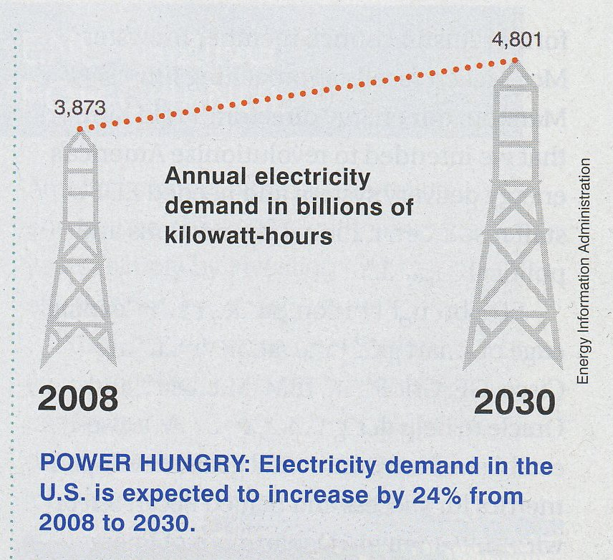

Slide 35
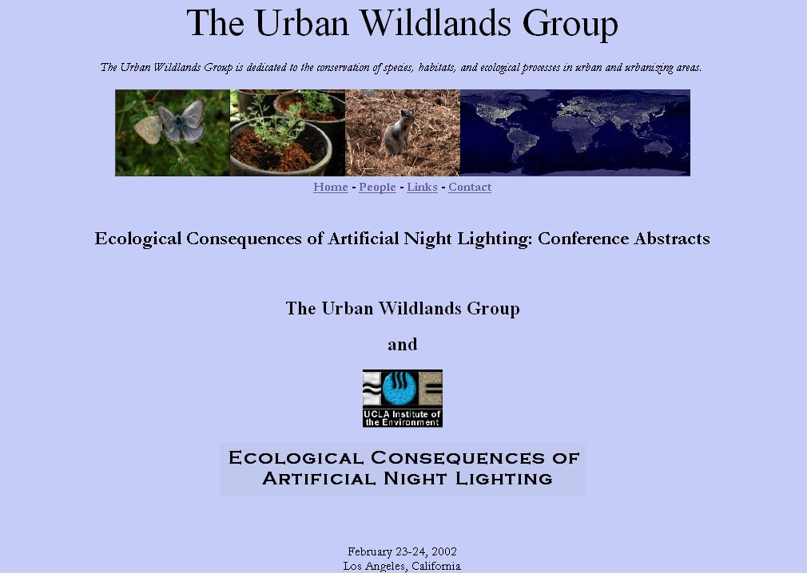
http://www.urbanwildlands.org/abstracts.html

Slide 36
Light Trespass Lawsuit - Pennsylvania
"Montgomery County (PA) Law Reporter"
Judge Honeyman, February 1, 1968 (page 142)
Hetzer et al v. Paparo et al
Paparo et al v. Hetzer et al
property located on Church Rd., Lafayette Hill

Slide 37
Light Trespass Lawsuit - Pennsylvania
The test for nuisance applied in Hetzer v. Paparo was that if the intensity of the light shining from the adjoining land is strong enough to disturb a person of ordinary sensibilities, it is a nuisance and must be corrected.
The court did not recognize any right to protection for persons who were hypersensitive to outdoor lighting.

Slide 38
Light Trespass Lawsuit - Colorado
http://www.lightlawsuit.com
Cash vs. Emich d.b.a. Elway Chrysler Jeep West & Elway Subaru West, Golden, Colorado
Colorado Court of Appeals in Denver. The appealed ruling was announced in September, 2006

Slide 39
Light Trespass Lawsuit - Colorado
The court held that the lights were an actionable nuisance. The jury also found that the defendants (the car dealerships) were creating, maintaining and/or allowing a nuisance to exist. Paraphrasing, the court held that the laws are sensitive to property owners rights to use and enjoy their private property, without having to close blinds or curtains on their windows to accommodate a business interest (the bright lights).

Slide 40
Light Trespass Lawsuit - Colorado
lawsuit has set a new precedent for nuisance light.
relief from bright light that is interfering with the use and enjoyment of their private property.

Slide 41
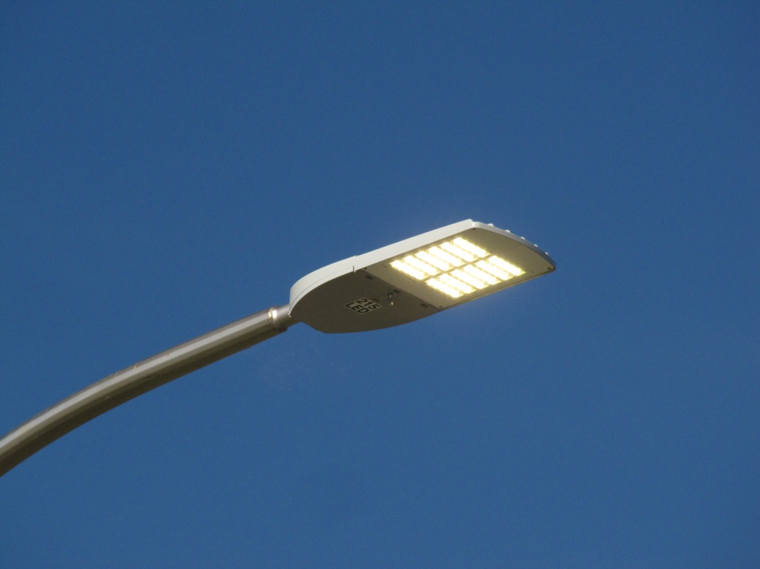
Light Emitting Diodes
We’re in an LED revolution…
Solid-state lighting has some advantages over conventional sources:
Long life
Energy efficiency
Reduced maintenance
No mercury
Inherently directional
Instant-on, dimmable
Tunable spectrum
Can be part of a digital infrastructure

Slide 42
Light Emitting Diodes
But:
Prone to glare: still must be shielded
Each emitter is like a bare bulb
Light output diminishes over time
- Electronic driver can fail
Still need to be cleaned
May still need replacement
  Lightning strikes
  Traffic accidents
  Storm damage

Slide 43
LED Choices
In addition to cost, safety and sustainability goals, LED sources are chosen based on qualities such as:
community acceptability, preference,
other aspects of aesthetics, color fidelity,
task performance, color discrimination,
object detection via color contrast…

Slide 44

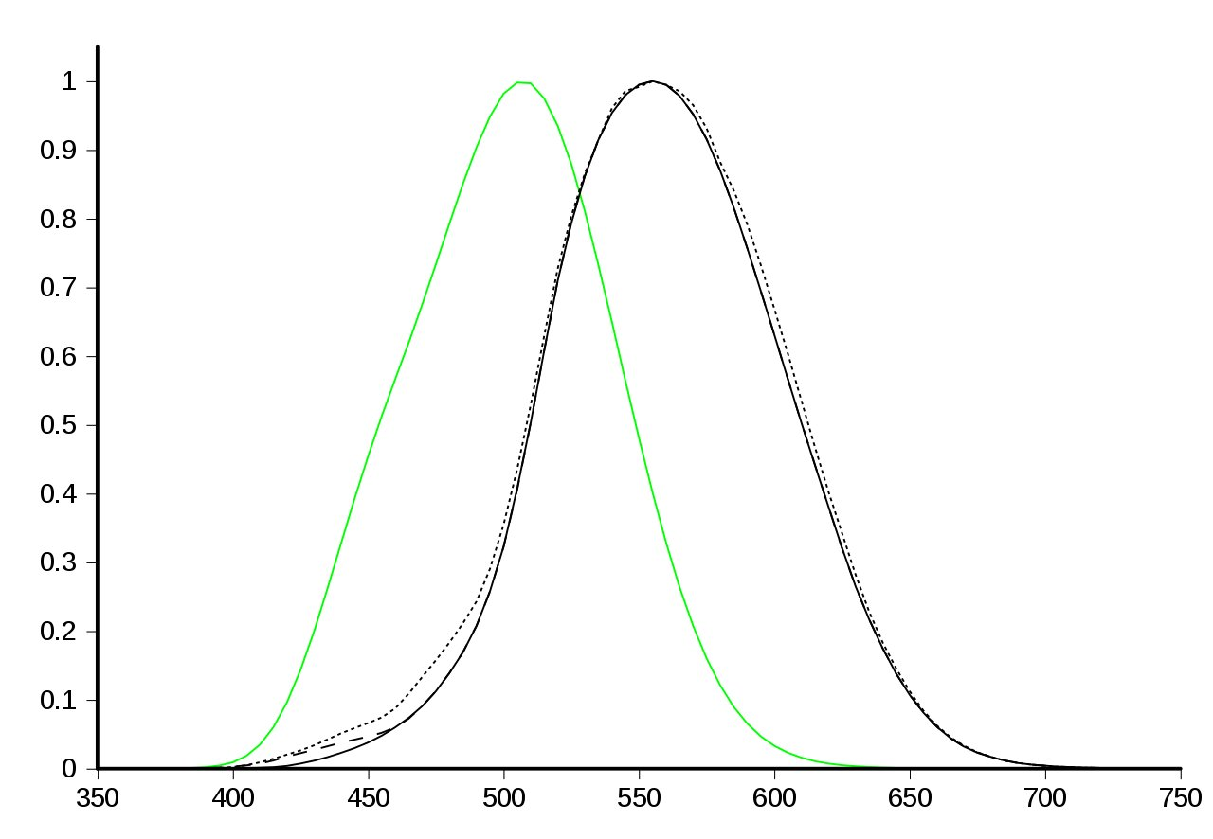
Human Vision
Human visual perception of brightness as a function of wavelength
Wavelength (nM)

Slide 45
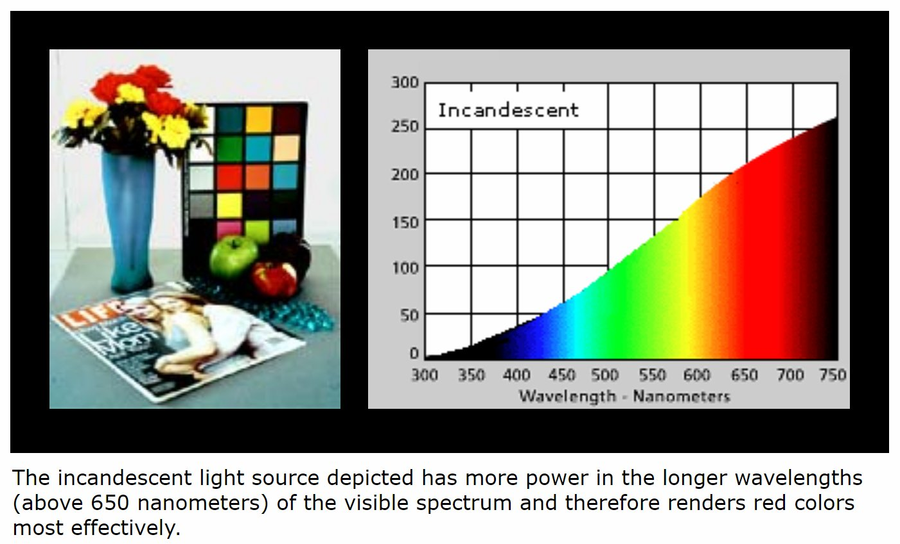
Spectral Power Distribution

Slide 46
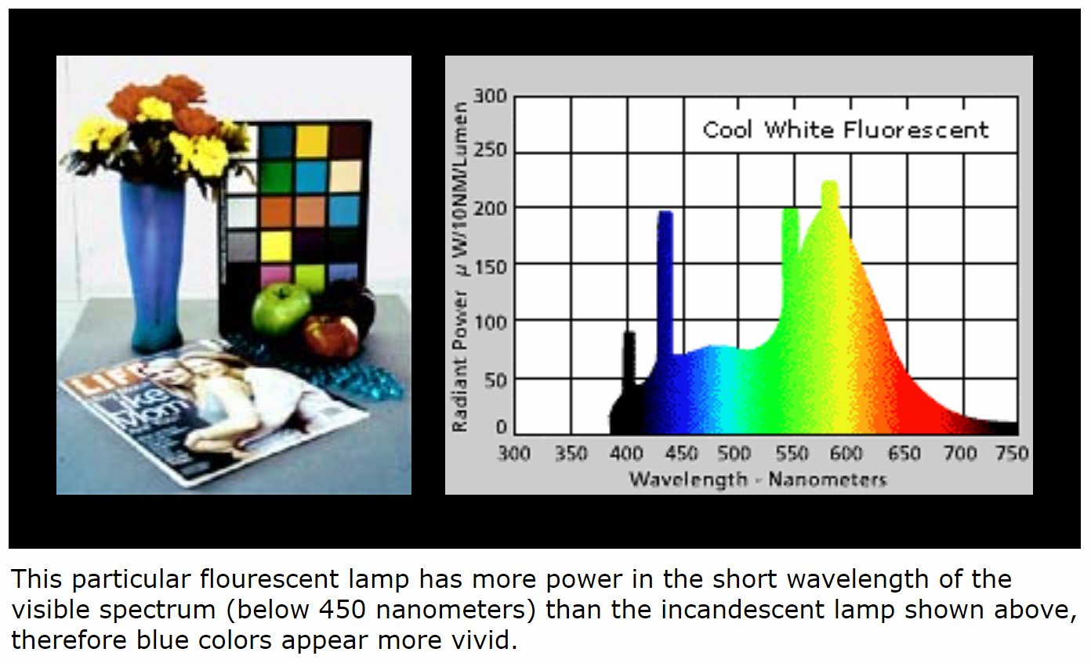
Spectral Power Distribution

Slide 47
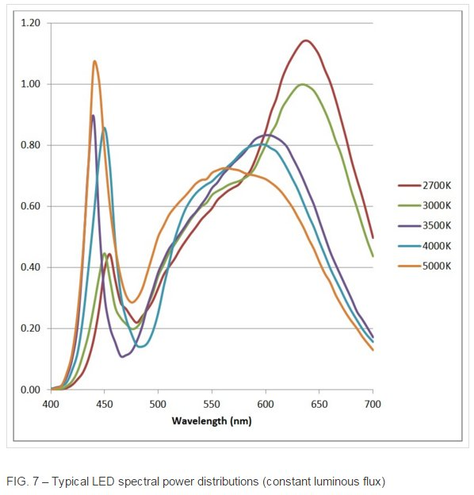
Spectral Power Distribution & CCT
Correlated color temperature (CCT) is a measure of light source color appearance
LEDs

Slide 48
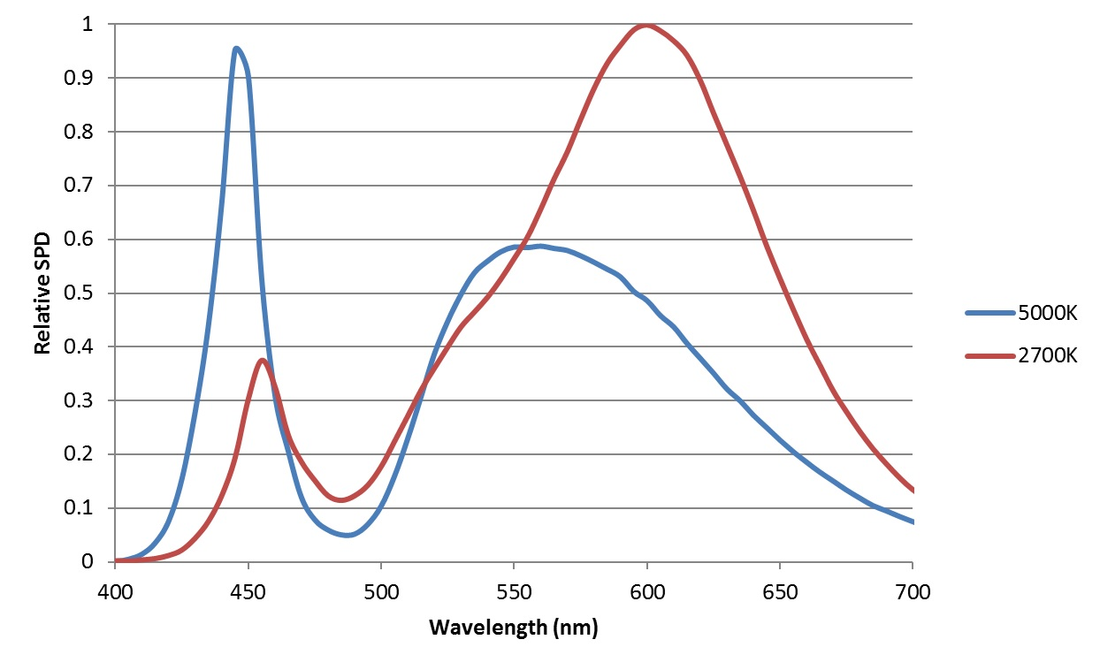
Spectral Power Distribution & CCT

Slide 49
Circadian Rhythm
- Circadian means "approximately daily".
- In addition to the circadian clock in our brains, every organ and tissue so far studied contains its own circadian clock, all regulated by the master clock in the brain.
- The master clock in the brain is set by the daily light/dark cycle of sunlight that comes from living on a rotating earth. - This cycle is present in all living things from plankton to primates.

Slide 50
Light as a “Drug”
- Light is a potent stimulus for regulating circadian, hormonal, and behavioral systems.
- In addition, light therapy is effective for certain affective disorders, sleep problems, and circadian rhythm disruption. In short, light acts like a drug.
- These biological and behavioral effects of light are influenced by distinct non-visual photoreceptors in the eye: melanopsin-containing intrinsically photosensitive Retinal Ganglion Cells (ipRGCs) in the retina, in addition to conventional rods and cones.

Slide 51
Light as a regulator of physiology and behavior
During the past three decades, empirical evidence has demonstrated that many aspects of human physiology and behavior are influenced by retinal illumination.
Such responses originate in the eye but are separate from other aspects of vision insofar as they are unrelated to particular spatial patterns of light exposure, and can survive even in some blind subjects.
- These types of light responses are referred to as non-visual.

Slide 52
Light as a regulator of physiology and behavior
Light on the retina resets our built-in circadian clocks. Because circadian rhythmicity is a feature of nearly every physiological, metabolic, and behavioral system, this phenomenon brings a wide array of biological processes under indirect retinal control.
These intrinsically photoreceptive Retinal Ganglion Cells (ipRGCs) achieve this photoreceptive capacity through expression of melanopsin, a photoreceptor protein.
- Many investigations based on selected wavelength comparisons of such responses in humans, non-human primates, and rodents revealed peak sensitivity in the short-wavelength blue-violet portion of the visible spectrum (from 447 to 484 nm).

Slide 53
Light as a regulator of physiology and behavior
LEDs are rich in the blue-violet wavelengths to which ipRGCs are sensitive. LED effect on ipRGCs depends their on SPD.
The traditional objectives of lighting include the provision of light that: (i) is optimal for visual performance; (ii) is visually comfortable; (iii) permits aesthetic appreciation of the space; and (iv) conserves energy.
- Light exposure has a broad range of effects on physiology and behavior. These non-visual effects of light should be an additional consideration in the design and operation of human lighting environments, as well as those for domesticated animals.

Slide 54
Light as a regulator of physiology and behavior
The radiative power of an LED summed across the range of wavelengths to which ipRGCs are sensitive determines the effect on melanopsin in the ipRGCs. This is called the melanopic content of the light, and is indicated by the “area under the curve” within the sensitive range, not just at the wavelength of peak sensitivity.

Slide 55
Light as a regulator of physiology and behavior
The LED manufacturer will provide the SPD from which the melanopic content can be calculated.
- CCT alone is not an adequate guide to melanopic content.
- Other things being equal, for light at night, lower melanopic content would be preferred.

Slide 56
Resources
Illuminating Engineering Society of North America (IESNA)
  the recognized technical authority on illumination
  communicate information on all aspects of good lighting practice
  over 100 publications including recommended practices on a variety of applications, design guides, technical memoranda, and publications on energy management and lighting measurement
  www.ies.org

Slide 57
Resources (Cont’d)
Lighting Research Center
at Rensselaer Polytechnic Institute, Troy, New York
http://www.lrc.rpi.edu/
World leading center for lighting research and education – pioneering research in solid-state lighting, light and health, transportation lighting, and energy efficiency

Slide 58
Resources (cont’d)
International Dark-Sky Association (IDA)
www.darksky.org Tucson, AZ
Est. 1988, educational, environmental 501(c)(3) nonprofit dedicated to protecting and preserving the nighttime environment and our heritage of dark skies through quality outdoor lighting.
With thousands of members in more than 70 countries, IDA is the leading authority concerning the problems and solutions related to light pollution.

Slide 59
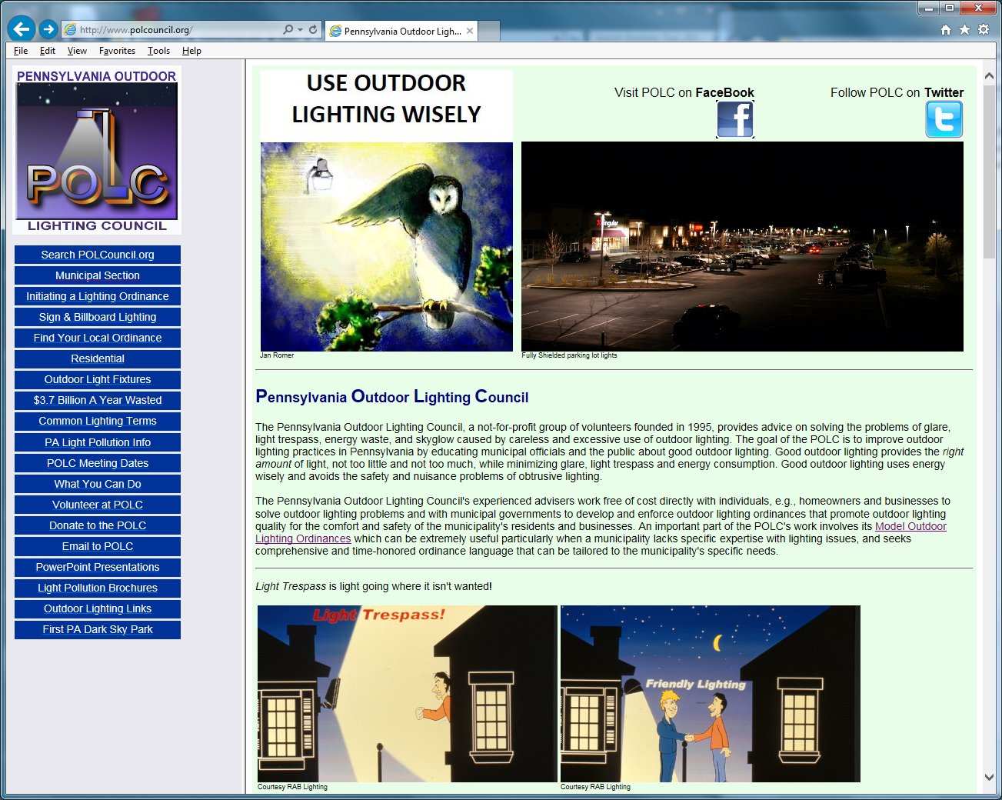

Slide 60
Recommendations
Improve Outdoor Lighting Practices
  Improves quality of life in our communities while saving money
  Promotes energy efficiency
Recognize Waste Outdoor Lighting as a significant environmental issue

Slide 61
Recommendations (Cont’d)
Promote the use of:
  Intelligent light controls, e.g. motion sensors, timers, programmable controllers
  Late night turn-off or dimming of all lighting except as needed for safety/security
  Fully shielded light fixtures to minimize glare light trespass, and wasted uplight

Slide 62
Conclusion
Don’t settle for bad lighting
An ordinance quantifies community expectations
Enact an effective ordinance and enforce it

